Slide 1
Impact of the Tevatron on Technology and Innovation
John Womersley
Chief Executive, STFC
11 June 2012

Slide 2
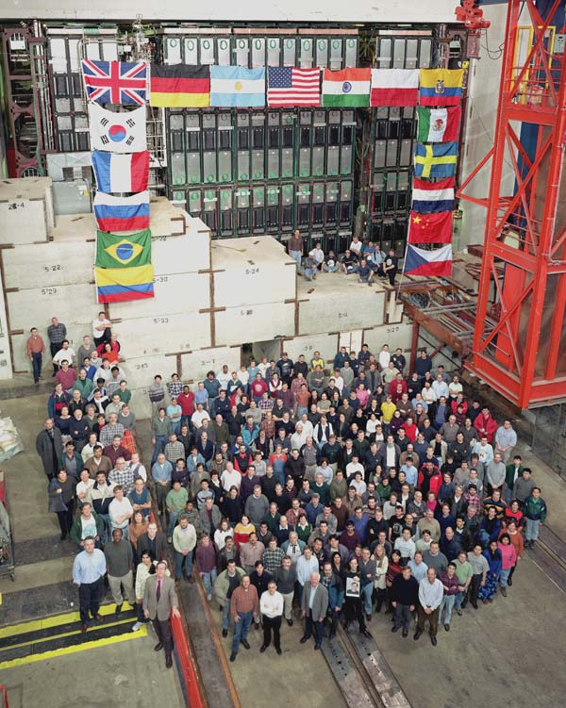

Slide 3
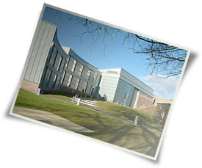
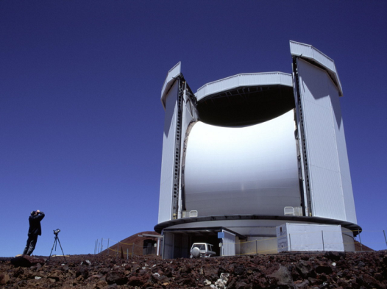
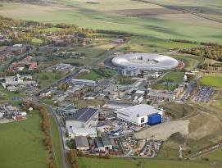

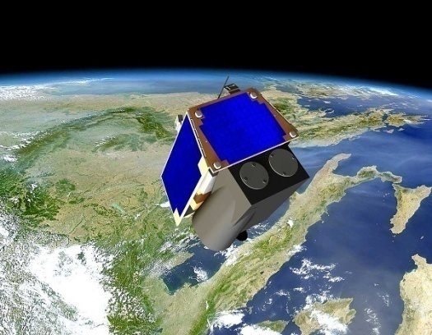
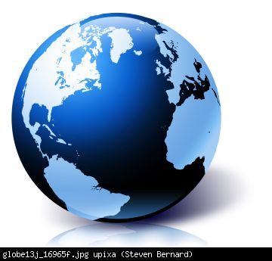
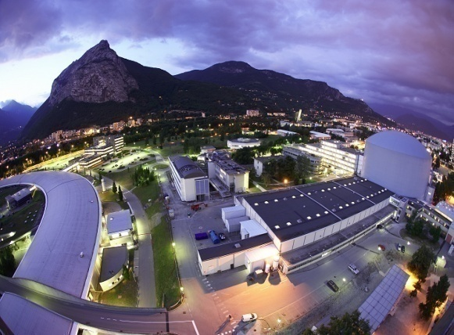
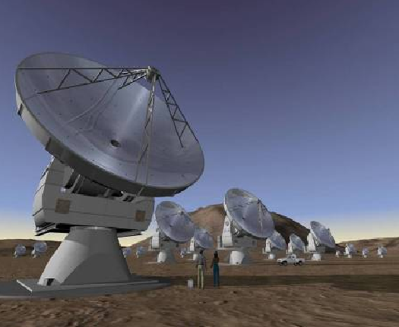
The Science & Technology Facilities Council
Research in UK universities, RAL and DL
JCMT Telescope
CERN: LHC
ESA: Top Sat
ILL and ESRF
ESO: Alma Array
Notes:
STFC employs around 1,700 staff over seven locations
Swindon, Head Quarters
Rutherford Appleton Laboratory in Oxfordshire, which is part of the Harwell Science and Innovation Campus
Daresbury Laboratory in Cheshire, which is part of the Daresbury Science and Innovation Campus
the UK Astronomy Technology Centre in Edinburgh
the Chilbolton Observatory in Hampshire
the Isaac Newton Group of Telescopes on La Palma in the Canary Islands
the Joint Astronomy Centre in Hawaii.

Slide 4
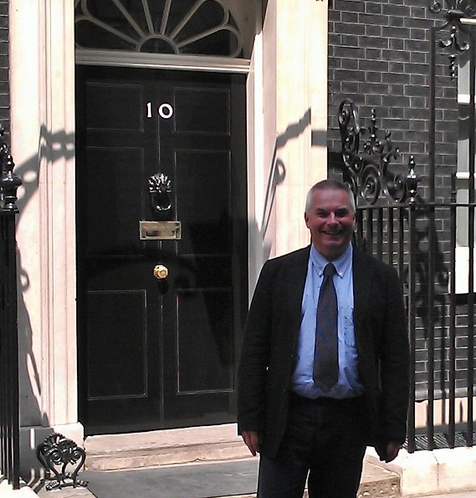

Slide 5
Why do governments support science?
$
Government
Science
Technological innovation, skills
Understanding of the Universe

Slide 6
Impacts
Can we try to measure the payoff from the investment made in the Tevatron?
  At least in the UK, case studies and examples are not enough: quantitative arguments are needed
Focus on three particular areas
  PhD students
  Impact on SC magnet technology
  Impact on Computing technology

Slide 7
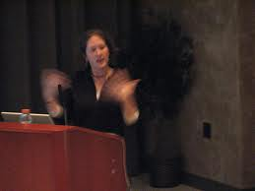

Health Warnings
Hand Waving
Back of envelopes

Slide 8

Debits

Slide 9
What did the Tevatron cost?
Tevatron accelerator
  $120M (1983) = $277M (2012 $)
Main Injector project
  $290M (1994) = $450M (2012 $)
Detectors and upgrades
  Guess: 2 x $500M (collider detectors) + $300M (FT)
Operations
  Say 20 years at $100M/year = $2 billion
Total cost = $4 billion

Slide 10
Credits

Slide 11
PhD Student Training
Value of a PhD student
  $2.2M (US Census Bureau, 2002) = $2.8M (2012 $)
Number of students trained at the Tevatron
  904 (CDF + DØ)
  492 (Fixed Target)
  18 (Smaller Collider experiments)
  1414 total
Financial Impact = $3.96 billion

Slide 12
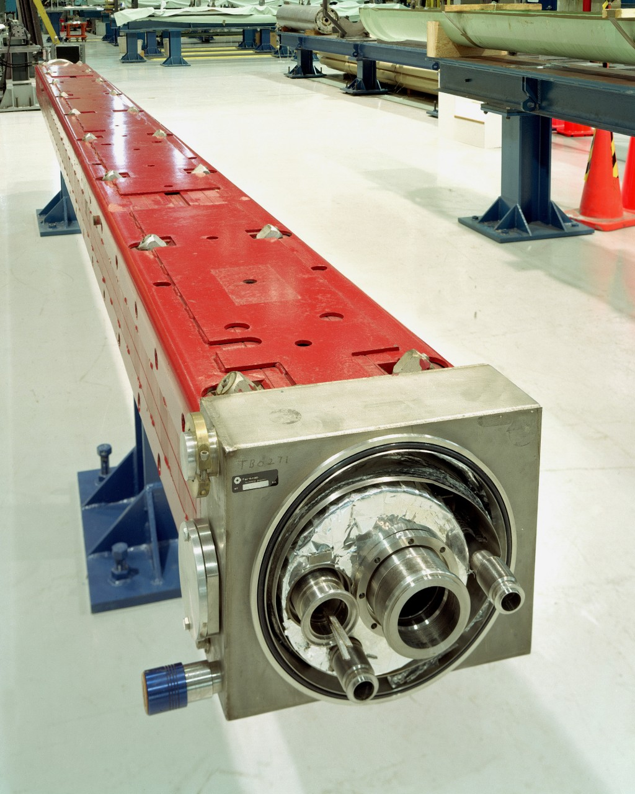
Superconducting Magnets
Tevatron was the first installation of mass-produced superconducting magnets on an industrial scale

Slide 13
Superconducting Magnets
National medal of Technology (1989)
Historic engineering landmark (1993)

Slide 14
Superconducting Magnets
Current value of SC Magnet Industry
  $1.5 Billion p.a.
Value of MRI industry (major customer for SC magnets)
  $5 Billion p.a.
This industry would probably have succeeded anyway – what we can realistically claim is that the large scale investment in this technology at the Tevatron significantly accelerated its development
  Guess – one to two years faster than otherwise?
Financial Impact = $5-10 billion

Slide 15
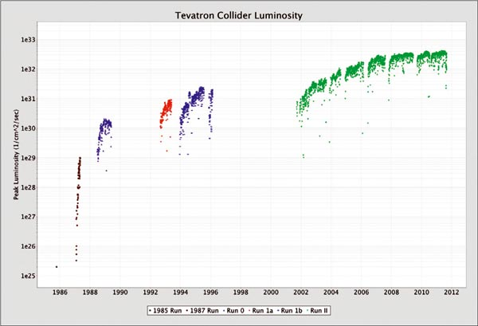
Computing
Increases in luminosity – driven by physics – created the challenge of processing ever larger datasets

Slide 16
Computing – Linux PC farms
MicroVAXes
Unix Farms in Run I
Computing requirements for Run II led to pioneering adoption of PC Farms running Linux for large scale data handling
  Fermilab PC Farm Exhibit in Supercomputing Conference SC 1997
  Linux Torvalds and Red Hat CEO Robert Young visit Fermilab; Fermi Linux released 1998
More than 90% of the world's supercomputers now use Linux

Slide 17
Distributed Computing
Concept of Computing as a Utility
  “The Grid” (1998)
Grid resources used for Monte Carlo generation and large scale reprocessing of Run II data
  DØ data shipped over the internet to Canada, France, Germany, Netherlands UK, and US universities, and processed data shipped back

Slide 18
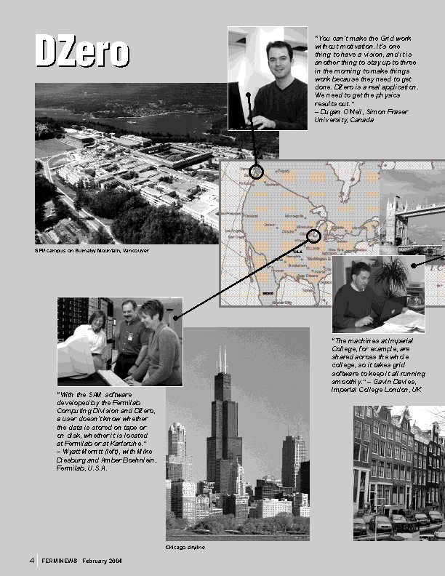
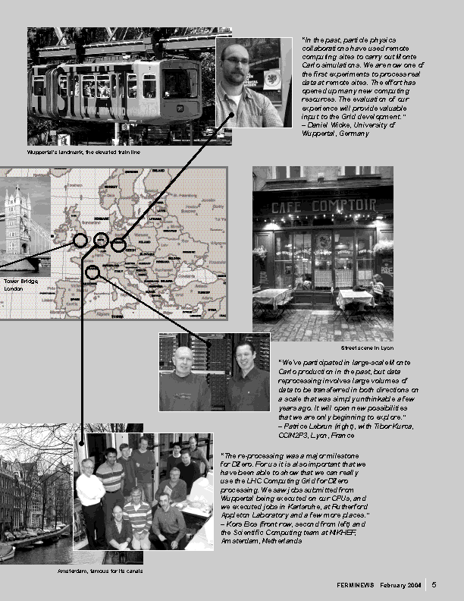
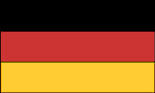





Ferminews 2004

Slide 19
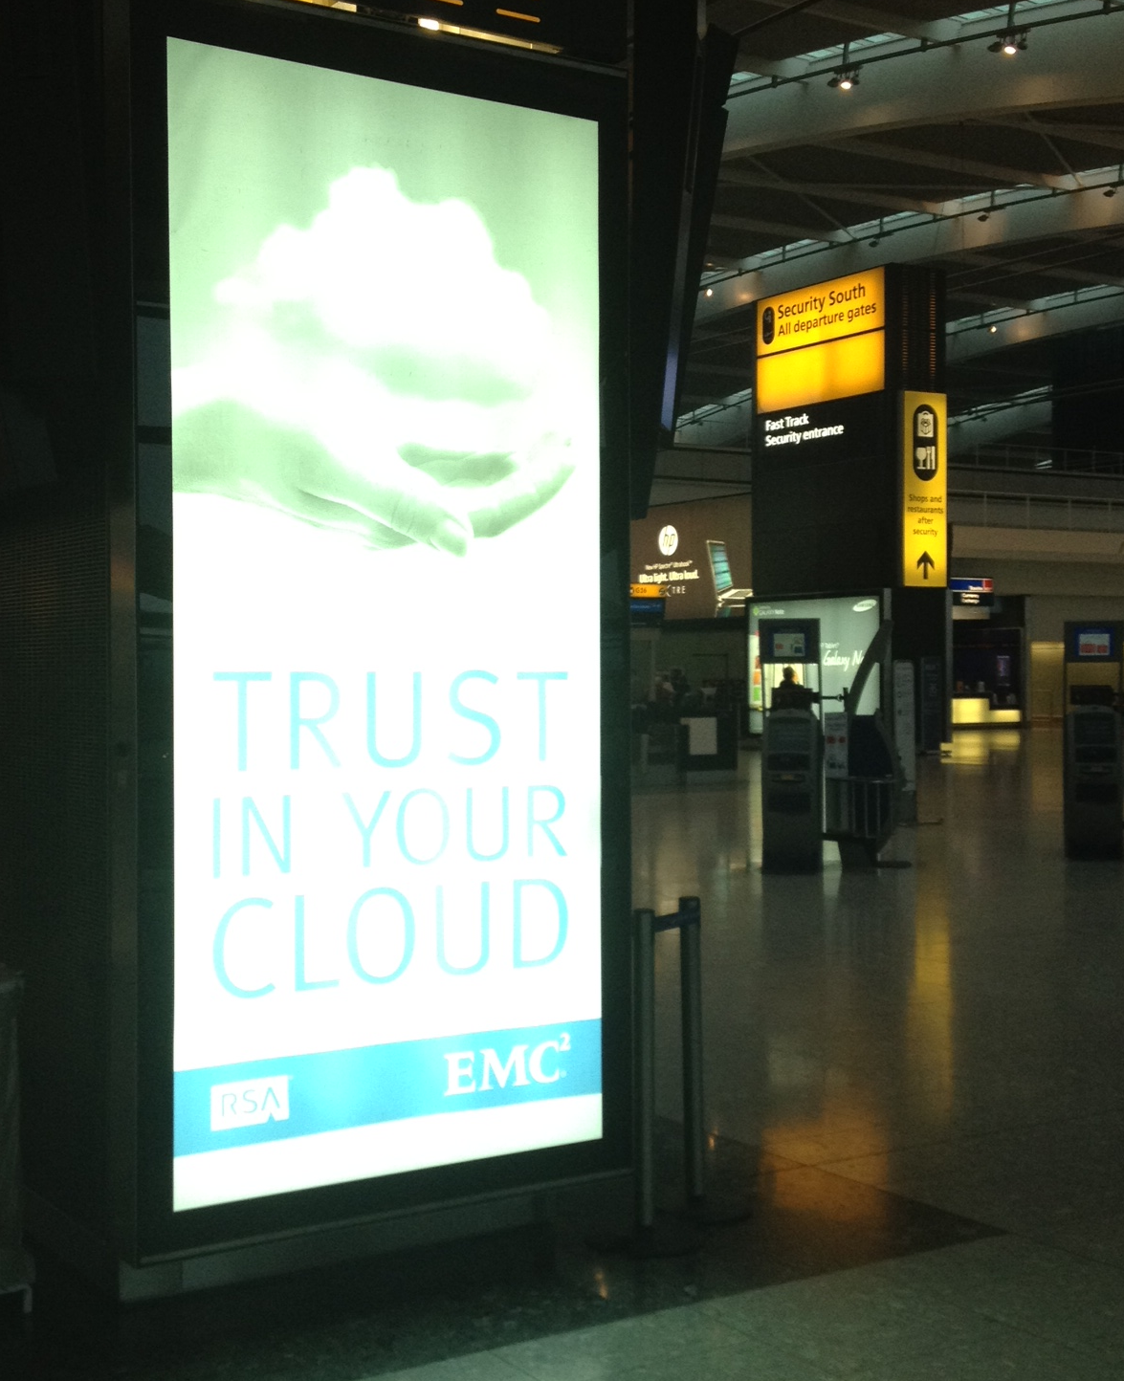
Cloud Computing
Remotely accessible Linux farms are now a commercial service
  Amazon etc.

Slide 20
Cloud Computing
Value of Cloud Computing Industry today
  $150 Billion p.a. (Gartner)
This industry would definitely have succeeded anyway – but let’s assume that the stimulus given by the Tevatron experiments, work with Red Hat etc. gave just a 3 month speed-up to its development
Financial Impact = $40 billion

Slide 21
Balance sheet
20 year investment in Tevatron ~ $4B
Students $4B
Magnets and MRI $5-10B ~ $50B total
Computing $40B
Very rough calculation – but confirms our gut feeling that investment in fundamental science pays off
I think there is an opportunity for someone to repeat this exercise more rigorously
cf. STFC study of SRS Impact
www.stfc.ac.uk/About+STFC/19005.aspx
}

Slide 22

Global collaboration in HEP
Tevatron experiments were also pioneers in establishing a genuine partnership between US, Japan and Europe
We need this approach again now
  CERN Council European Strategy Process
  US community process
  Japanese roadmap under development
Breakthrough discoveries coming
  opportunity to shape a science-driven strategy

Slide 23
Global collaboration in HEP
Needs to be a global strategy
  Complementary pathways through a common landscape
  CERN’s focus will be on energy frontier at LHC
  Main questions: how (and where) to progress neutrino physics, precision measurements and astroparticle physics?
I hope other regions will see the scientific logic and political importance of supporting a strong US program in these areas

Slide 24
Conclusions
Especially in tough economic times, the non-science impacts of major projects are an important part of the case we must make
  “What will it do for jobs and economic growth?”
Impacts tend to be long term and unpredictable – so one way to make the case for future investments is to look back at the benefits from past examples
Here I’ve tried to make a plausible case that the Tevatron has returned its investment roughly tenfold over its life
  A more detailed study along these lines may well be worthwhile

