Slide 1
Tevatron
Graduation Day
Tevatron Impact Symposium
Keynote
Lisa Randall

Slide 2
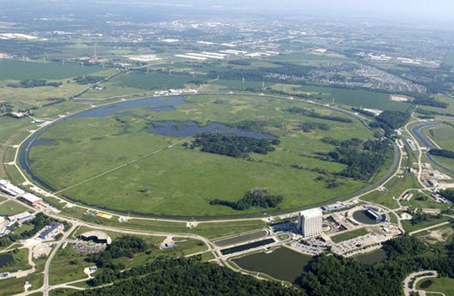

Slide 3
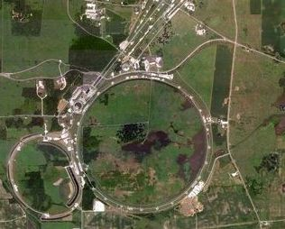

Slide 4
Graduation
grad·u·a·tion
[graj-oo-ey-shuhn
noun 1. an act of graduating; the state of being graduated.
2. the ceremony of conferring degrees or diplomas, as at a college or school.
Today we celebrate the impact and legacy of the Tevatron
Both in terms of science and in its influence on technology and creative scientific thinking

Slide 5
Legacy
Momentous time in particle physics.
  Transition.
  Many eyes on LHC.
But really what got a lot of us into particle physics was what was happening “next door.”
Which is to say here in Batavia Illinois.
Spectacular successes
  Advances both in technology
  And science
  As successful as it could have been
Tevatron (and engineers and scientists who created and ran it) graduate
  summa cum laude

Slide 6
My First Fermilab Experience
Predates Tevatron
Summer student 1982
Charm fixed target E516
  (thanks to David Bintinger and Mike Sokoloff, Drasko Jovanovic, Chris Quigg)
Great opportunity to get acquainted with particle physics
Could dive right into analysis
Learn a number of things:

Slide 7
What I Learned
People and buffalo can live in close promixity
Feed corn never gets soft, no matter how long you cook it
  (dinner party from fellow student…)
Chicago mayors buy the loyalty of the populace with some rather excellent free festivals:
  Chicago Jazz Festival
    Miles Davis AND Alberta Hunter (among others…)

Slide 8
And of course
Standard Model and its implications
Physics experiments absorbing
Fitting it all together very satisfying
And many excellent people involved

Slide 9
Other experiences
Stayed on site with other visitors
British experimenter returning from a drunken binge
“CERN has to find the “bloody vector boson”
  Made an impression.
“All the discoveries being made in America and it was time for Europe.”
Before the Tevatron.
  Impressive feats of ingenuity.
  Optimize existing facility

Slide 10
25 Major Years for Particle Physics
A quarter century of Tevatron
  Centerpiece from December 1985 until 2011
A quarter century of running of LHC preparation
  Essentially same time frame
A quarter century of my physics career
  And those of my cohorts

Slide 11
Achievements
Explored physics up to 1.96 TeV
Initial design luminosity 10³⁰ cm⁻² sec⁻¹
  Delivered over 400 times that to both D0 and CDF experiments
  A machine that ran BETTER than projected
Many notable milestones
  Even when setbacks came back on target or better
Many critical technological advances

Slide 12
The Energy Saver/Doubler
Bob Wilson originally intended to double energy from 500 GeV to 1 TeV
Key idea: reduce power consumption through superconducting magnets
Major technology advance we take for granted today
  Allowed Tevatron with original 6.3 km Main Ring
    1970s development
    1983 original commissioning
    Fixed target accelerator that year

Slide 13
The Tevatron
Antiproton Source 1985
1st collisions with proto-CDF
  Real data starting in 1987
  More 1988,1989
  5 pb⁻¹ at 1800 GeV cm
  Design luminosity exceeded!
Run Ia, 1b (1993)
  Impressive improvements
  1.6 10³¹ cm⁻² sec⁻¹
  60% Improvement over Run I goal

Slide 14
Main Injector Synchrotron and
Recycler Storage Ring
March 2001 to Sept 2011
Luminosity goal 8 10³¹ (x 2.5) cm⁻² sec⁻¹
Setbacks but ultimately 3.4 10³² cm⁻² sec⁻¹
  Again in excess of expectations
Peak luminosity grew by over 50 during ten years
  Series of improvements throughout operation

Slide 15
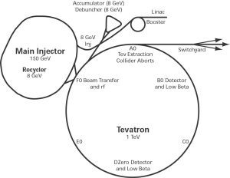

Slide 16
Technology Advances
Superconducting magnets
  Used in all major accelerators since
  Design issues addressed: strands, geometry, support, cooling, protection
Recycler permanent magnets
Stochastic cooling of antiprotons
Other improvements you will hear about later…

Slide 17
Experimental Advances
Silicon Vertex Detectors
  Introduced key possibilities for 3rd generation physics
  Clever use of information that was being lost
Calorimetry
Triggering Techniques
Analysis Techniques

Slide 18
Not my focus but…
Impressive to watch development of machine
  And experiments
Maximize use of the existing facility until its ultimate expiration date
Ingenuity, hard work, and diligence combined to get performance to where it was
Resulting in beautiful physics results…

Slide 19
Physics of the Tevatron:
The Unsung Hero
Discovery
  Top quark in particular
  Could have been other stuff had it existed at those energies…
AND precision measurements
  At a hadron collider!
  Precision measurements for electroweak physics, QCD, and flavor

Slide 20
Flagship achievement
Discovery of top quark 1995
  ONLY place it was made for 15 years
After years of not finding it…
  No reason to expect it to be so heavy
Heavy enough had to look for decays into b and W
  Which themselves decay
  Many analysis teams had to work together to find evidence and establish its existence
Since: mass measurement, cross section, interactions…

Slide 21
QCD
Jet cross sections
Gluon initiated jets
Parton distributions
Strong coupling measurement
Agreement with SM constrains physics beyond SM

Slide 22
Precision Electroweak
W mass measurement
Top quark mass measurement
  Recall top mass parameter present in addition to ew parameters themselves
  Isolating top depce determines (Higgs and) new physics constraints
Electroweak gauge boson production rates

Slide 23
Report Of The Electroweak Interactions Theoretical Issues Working Group.
Mitchell Golden (Fermilab), H. Baer, Vernon D. Barger, U. Baur, Ikaros I.Y. Bigi, E. Eichten, Tao Han, C.S. Kim, D. Morris, Lisa Randall et al. Show all 14 authors.
Nov 1989
14 pp.
In *Breckenridge 1989, Proceedings, Physics at Fermilab in the 1990's* 112-125 and Fermilab Batavia - FERMILAB-Conf-90-043 (89,rec.Mar.90) 14 p
Presented at Conference: C89-08-15
FERMILAB-CONF-90-043-T,C89-08-15,FNAL-C-90-43-T
Keyword(s): INSPIRE: talk | anti-p p: interaction | interaction: anti-p p | W: hadroproduction | hadroproduction: W | Z0: hadroproduction | hadroproduction: Z0 | photon: associated production | associated production: photon | electroweak interaction: validity test | validity test: electroweak interaction | jet: associated production | associated production: jet | jet: multiple production | multiple production: jet | quantum chromodynamics: validity test | coupling: (3gauge boson) | (3gauge boson): coupling | intermediate boson: mass | mass: intermediate boson | Z0: decay | decay: Z0 | angular distribution: asymmetry | asymmetry: angular distribution | postulated particle: Z' | Z': hadroproduction | hadroproduction: Z' | mass: Z' | Z': mass | grand unified theory: E(6) | Higgs particle: hadroproduction | hadroproduction: Higgs particle | mass: top | top: mass | Weinberg angle | numerical calculations | proposed experiment | bibliography | 2000-3600 GeV-cms

Slide 24
Radiative Corrections To Electroweak Parameters In Technicolor Theories.
Mitchell Golden (Fermilab), Lisa Randall (LBL, Berkeley).
May 1990
25 pp.
Nucl.Phys. B361 (1991) 3-23
FERMILAB-PUB-90-083-T,LBL-29050,NSF-ITP-90-82
Tevatron also played role in precision electroweak studies
Not only in experiment but inspiring theory
Better understanding W boson mass was critical to theoretical developments
From ρ parameter and beyond

Slide 25
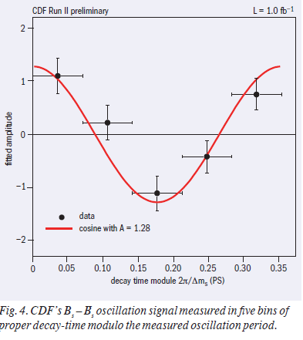
Other Heavy Flavor Physics
D Mesons
Mass, lifetime B_{s}
B baryons
Rare decays
B_{s} mixing 2006
  Phenomenal achievement

Slide 26
Inspired to Study
CP Violating Leptonic Decays
CP violating lepton asymmetries from B decays and their implication for supersymmetric flavor models.
Lisa Randall, Shu-fang Su (MIT, LNS).
Jul 1998
21 pp.
Nucl.Phys. B540 (1999) 37-57
Nucl. Phys. B540 (1999) 37-57
hep-ph/9807377,MIT-CTP-2755,CERN-TH-98-159
e-Print: hep-ph/9807377 Abstract: The lepton and dilepton charge asymmetries from Bd and Bs are predicted to be small in the standard model, whereas new physics could increase their values significantly. In this paper, we explore the use of the lepton asymmetries as a probe of the flavor structure of supersymmetric theories. In particular, we determine the sensitivity to parameters of various models. We find that in many interesting models which attempt to address the supersymmetric flavor problem, the mixing structure is such that it could be possible to detect new physics. The predictions are model dependent; with a measurement in both the Bs and Bd systems one can hope to constrain the flavor physics model, especially once squarks are detected and their masses measured. Thus, lepton charge asymmetries can be used as an alternative means of searching for new physics and distinguishing among potential solutions to the flavor problem. They are interesting precisely because they are small in the standard model and are therefore necessarily evidence of new physics.
Told not possible…

Slide 27
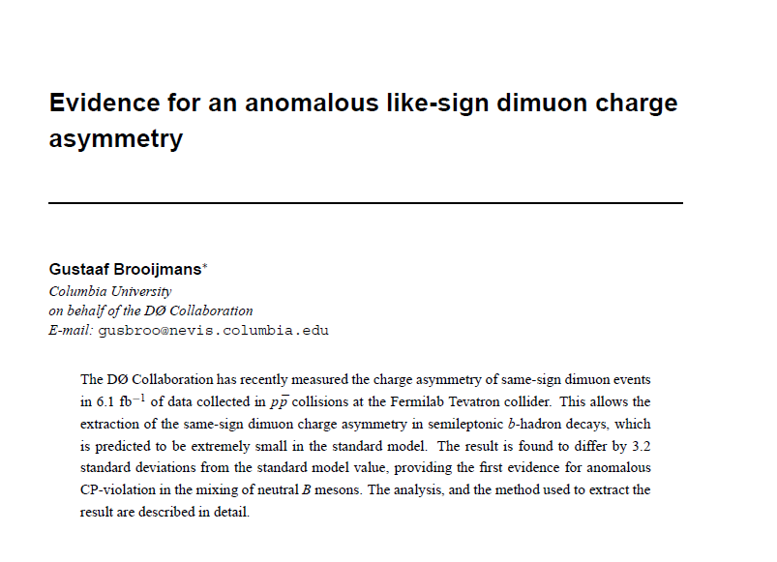

Slide 28
And of course…Higgs Physics
Constrain mass
  Contributing to precision electroweak constraints
Excluding large parameter region directly
Even possibly seeing hint of decay into bottoms

Slide 29
For me…
Summer student experience
Working on SM precision EW
Working beyond SM
  Seeing measurements we thought wouldn’t be possible get realized
Detailed understanding
Truly inspirational

Slide 30
Role of Tevatron
Explore frontiers—energy or intensity
Inspire people with what is possible
Technological achievements
  Not just gadgets—true advances in techniques and knowledge
Theoretical ideas
Inspire big thoughts
Key steppingstone on path to understand small scales

Slide 31
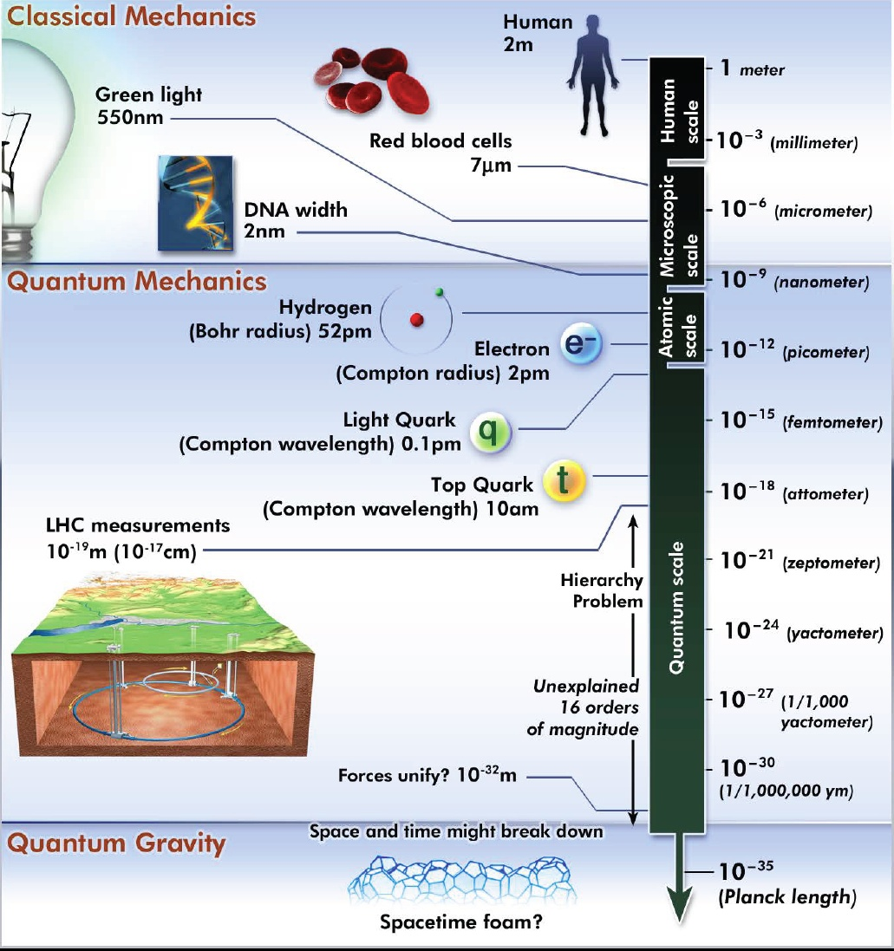
Study Small Scales

Slide 32
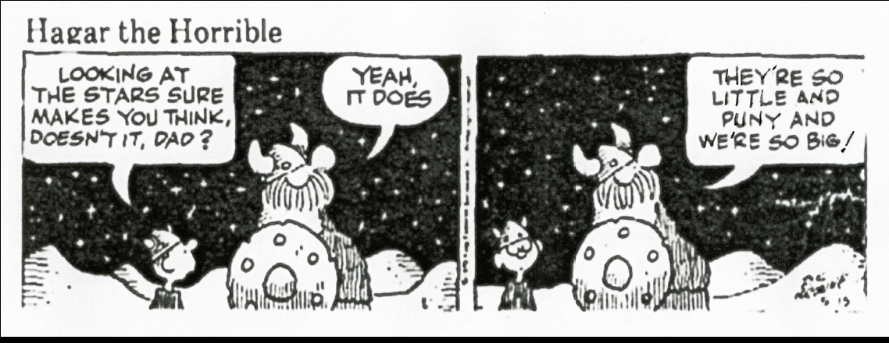
Reach for the Stars
Small scales as inspirational
And contain the real mysteries

Slide 33
Steve Jobs’ Words
Again, you can't connect the dots looking forward; you can only connect them looking backwards. So you have to trust that the dots will somehow connect in your future.

Slide 34

Honorary Degree
The Tevatron
June 11
All Evolved Lifeforms
xx

