Slide 1

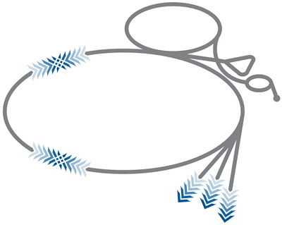
On the Large Hadron Collider
- Collider
- Experiments
R.-D. Heuer, CERN Fermilab, June11, 2012

Slide 2
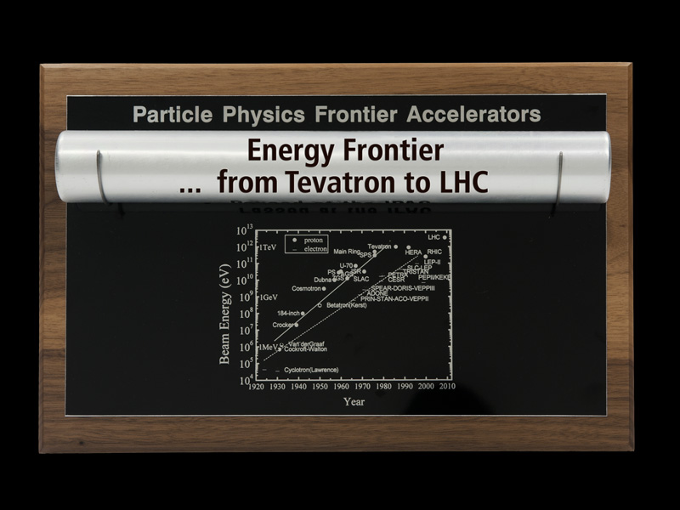
Energy Frontier Baton
Moving magnet current leads (almost everywhere)

Slide 3
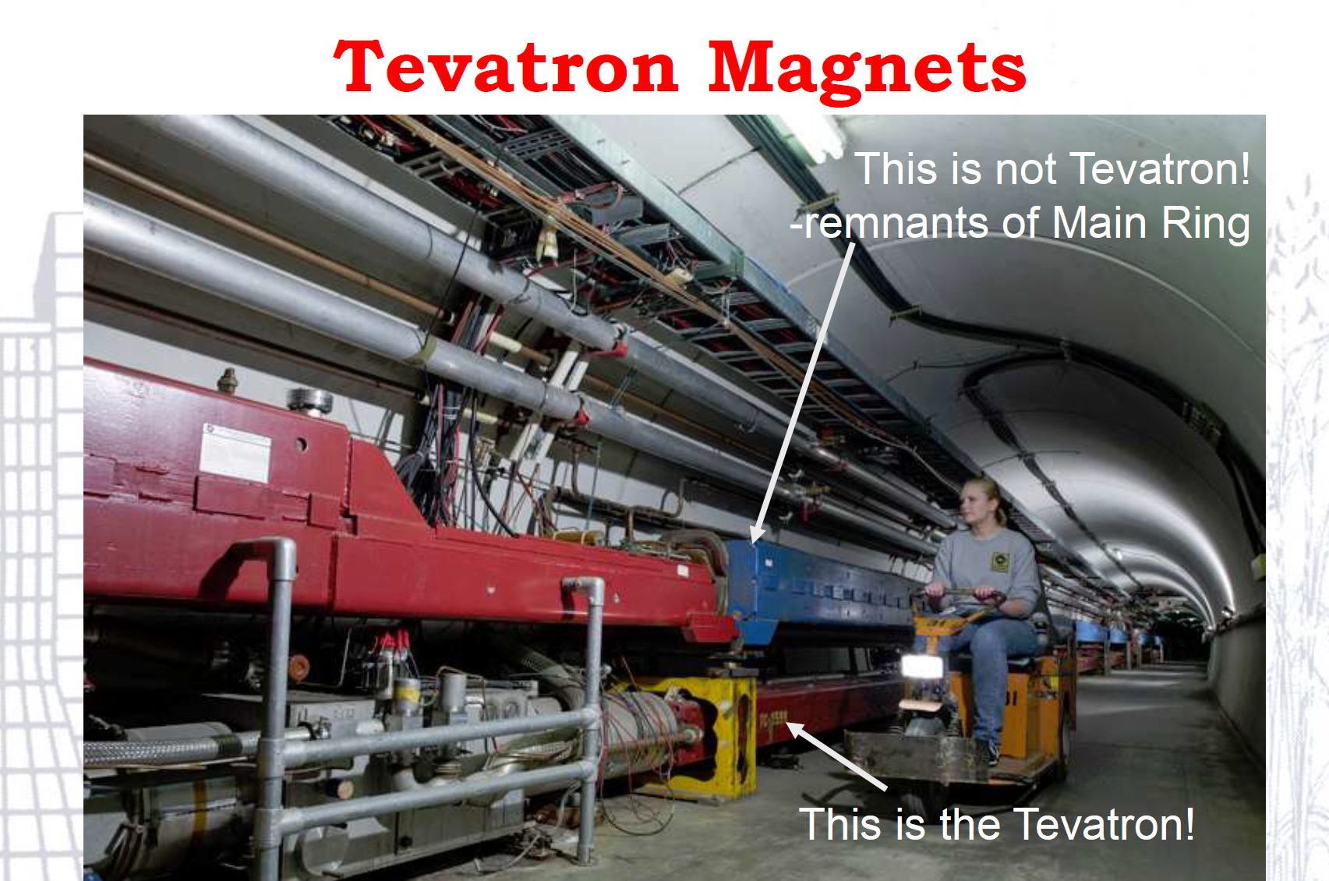
from . . .Tevatron

Slide 4


to . . . LHC
Moving magnet current leads (almost everywhere)

Slide 5
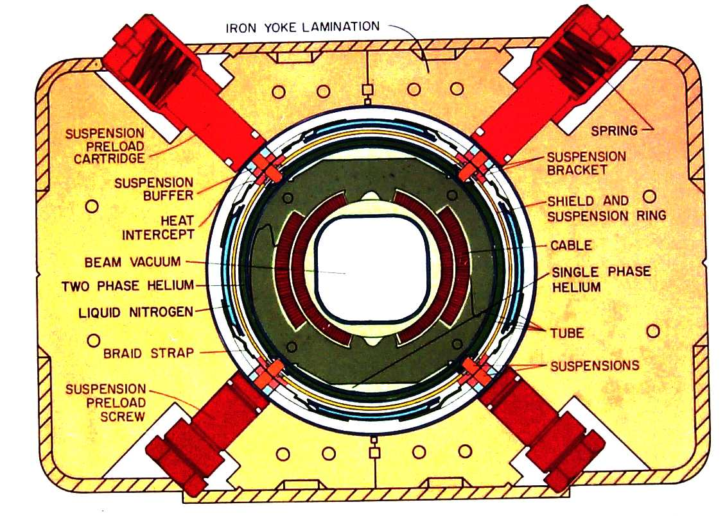
FNAL → CERN (I)
Tevatron SC magnet technology
4.5T SC Magnets

Slide 6
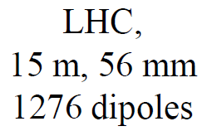
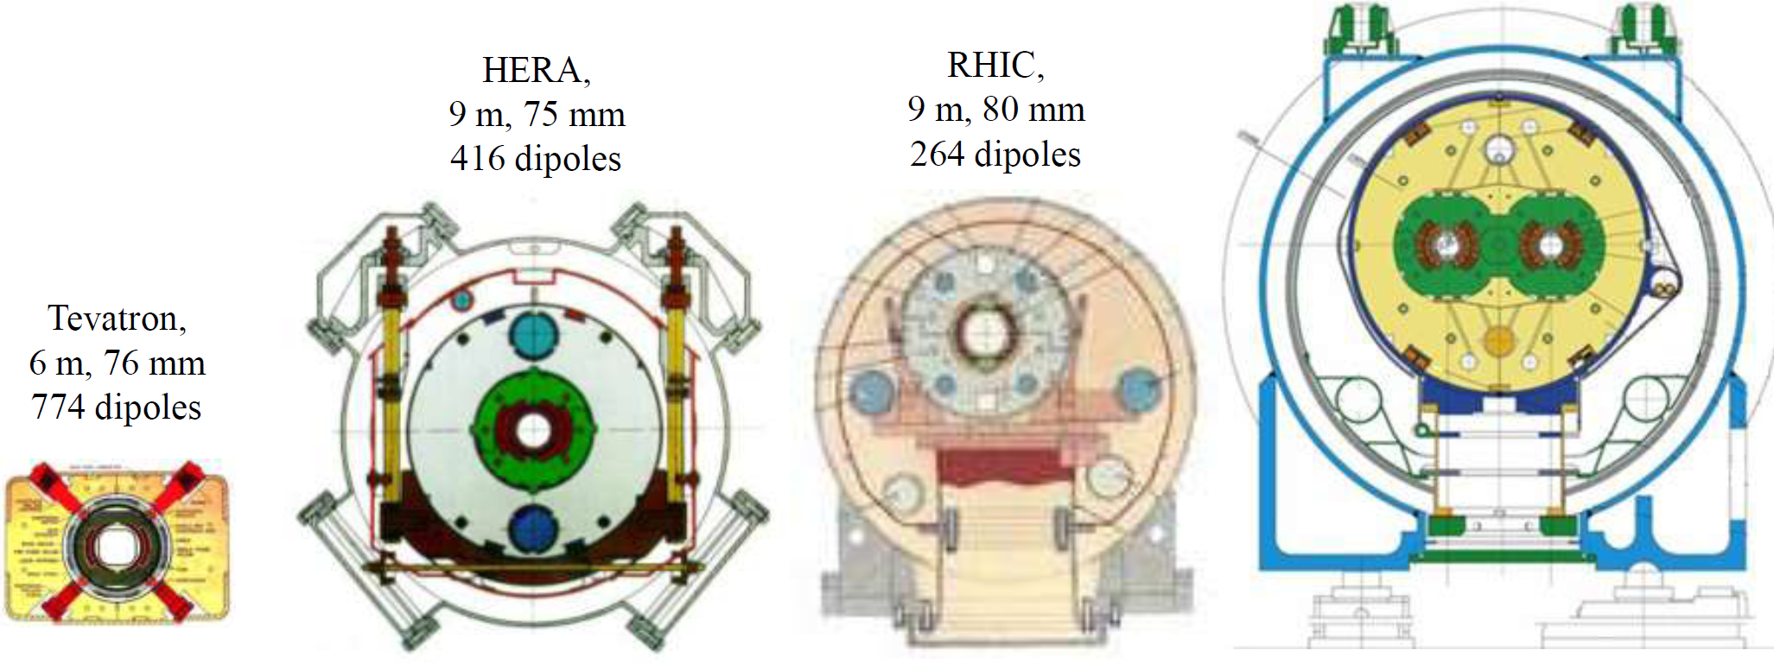
SC Magnets
Tevatron paved the way for HERA, RHIC and LHC
8.3T
4.5T
5.3T
3.5T
warm iron small He-plant
cold iron
Al collar
simple &
cheap
2K He
two bores

Slide 7
FNAL → CERN (I)
Tevatron SC magnet technology
Stochastic cooling
(FNAL learnt and greatly advanced the method)
LHC magnets for the interaction region
(important US contribution)
Technical help for LHC
- during commissioning
- during recovery in 2008/2009

Slide 8
FNAL → CERN (II)
Advances in Beam Physics/Technology:
  TeV experts’ participation in commissioning/beam studies (LARP teams)
  Strong involvement in the upgrades
  (Nb₃Sn magnets, Energy Deposition, optics, etc)
  Beam-beam effects in hadron beam (SPS experience → Tevatron + studies + modeling tools → LHC)
  Collimation ideas going to realization : hollow electron beams, bent crystals

Slide 9
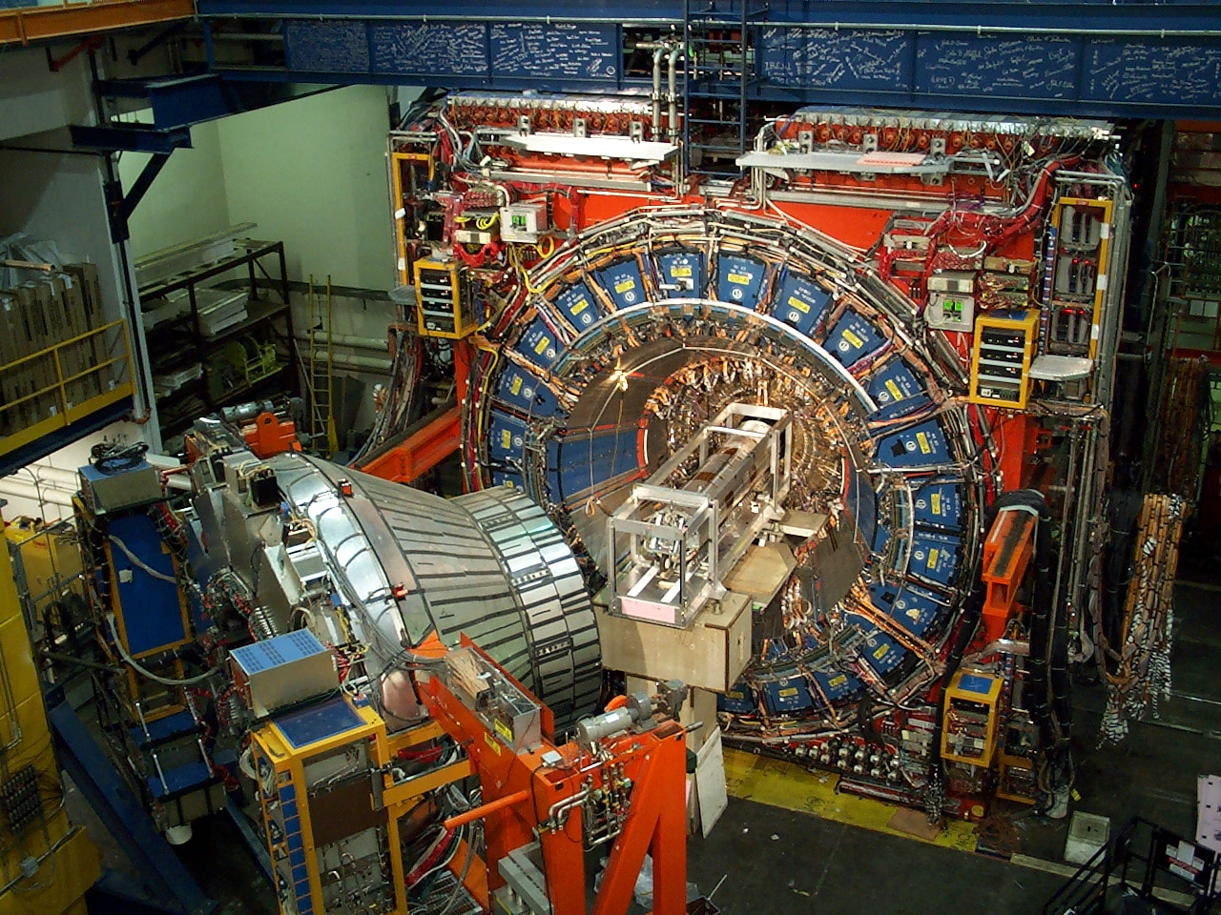
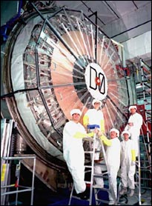
from . . .Tevatron Experiments

Slide 10

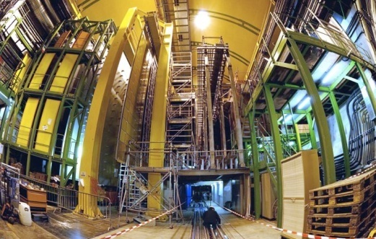
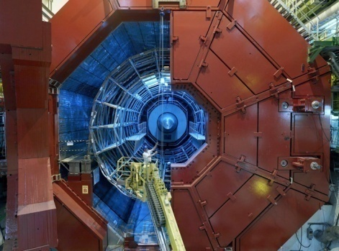

to . . . LHC Experiments
Moving magnet current leads (almost everywhere)
CMS
LHCb
ALICE
TOTEM
LHCf
MOEDAL
ATLAS

Slide 11
General Remark
The Tevatron experiments faced a very similar hadronic environment
although at lower energies
  (But keep in mind that the early CDF and D0 years were also heavily influenced by the CERN-SPS experiments, UA1 and UA2)

Slide 12
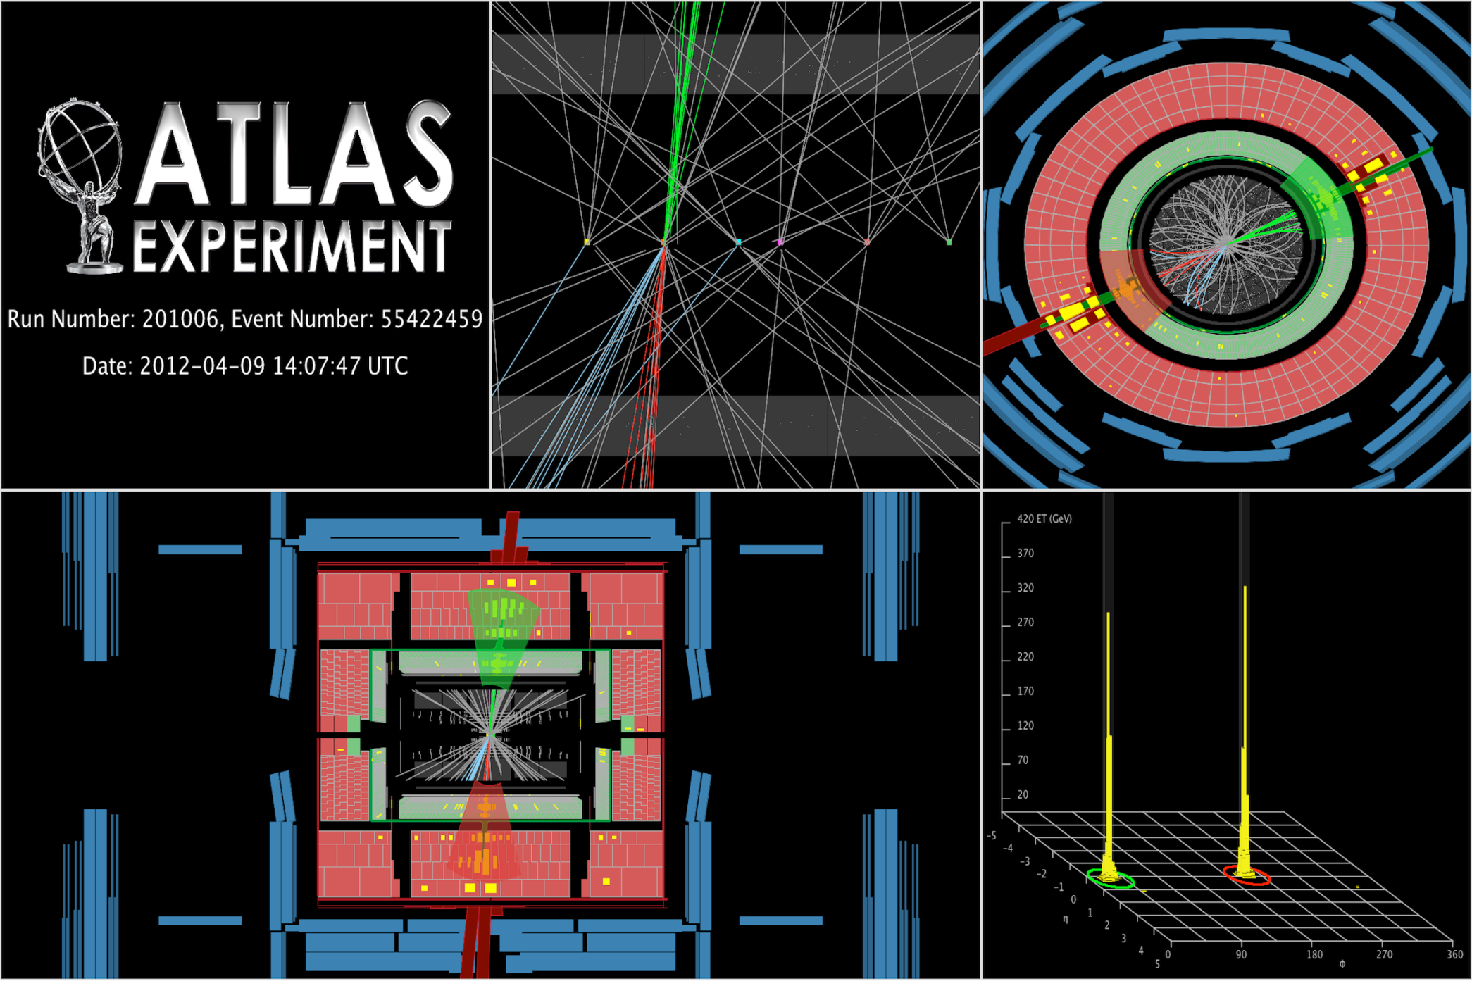
Di-jet event recorded by ATLAS on 9 April 2012 at √s=8 TeV
1.96 TeV = 1 Tevatron !!
Leading jet p_{T}
p_{T} (j,j)= 1.96, 1.65 TeV, M (jj) = 3.6 TeV

Slide 13
Hardware and Analysis Techniques
Run 1 CDF demonstrated that very good tracking can make up for deficiencies in calorimetry and allow many new physics topics to be breached
  Especially as a result of silicon detectors
  B tagging was widely developed and used at the Tevatron
  → precision B-physics at hadron colliders
  Many top physics techniques and analysis techniques in general
Run 2 CDF and Dzero detectors were very relevant to the LHC because they were a step up in complexity and of course operated in a similar environment
  Many things were learned from Run 2
    Both in terms of what to do and what not to do
  Silicon tracking and vertexing was taken to a new level at the Tevatron

Slide 14
Trigger and Analysis Techniques
The entire triggering concept in hadron collider environment comes from the Tevatron (and earlier machines)
  Tevatron has pioneered SVT but also out-of-time triggers (for slow-moving or long-lived particles)
The importance of the MVA techniques.
  Tevatron was the first to capitalize on the new qualitative break-through offered by modern computing: an ability to train MVA methods on large samples of data and MC and use it instead of the matrix element approach (also pioneered by the Tevatron), which often only is possible at leading order.
  These techniques were used to find single-top production at the Tevatron; they are likely to play crucial role in the Higgs discovery at the LHC.
The importance of combination of multiple channels
  For the Higgs search, the Tevatron demonstrated that adding a large number of relatively insensitive channels does help the overall sensitivity.

Slide 15
Physics Analyses
Methods innovated at Tevatron, carried over to LHC
  Ingenious methods of overcoming constraints
  Example – Jet energy scale (JES) uncertainty dominated top mass uncertainty-> use hadronic W inside top events themselves to calibrate JES. Simultaneous fit to JES and Top mass allows high precision
Tevatron showed that one can do extremely high precision measurement
  E.g. recent W mass σ_{M}~16 MeV !

Slide 16
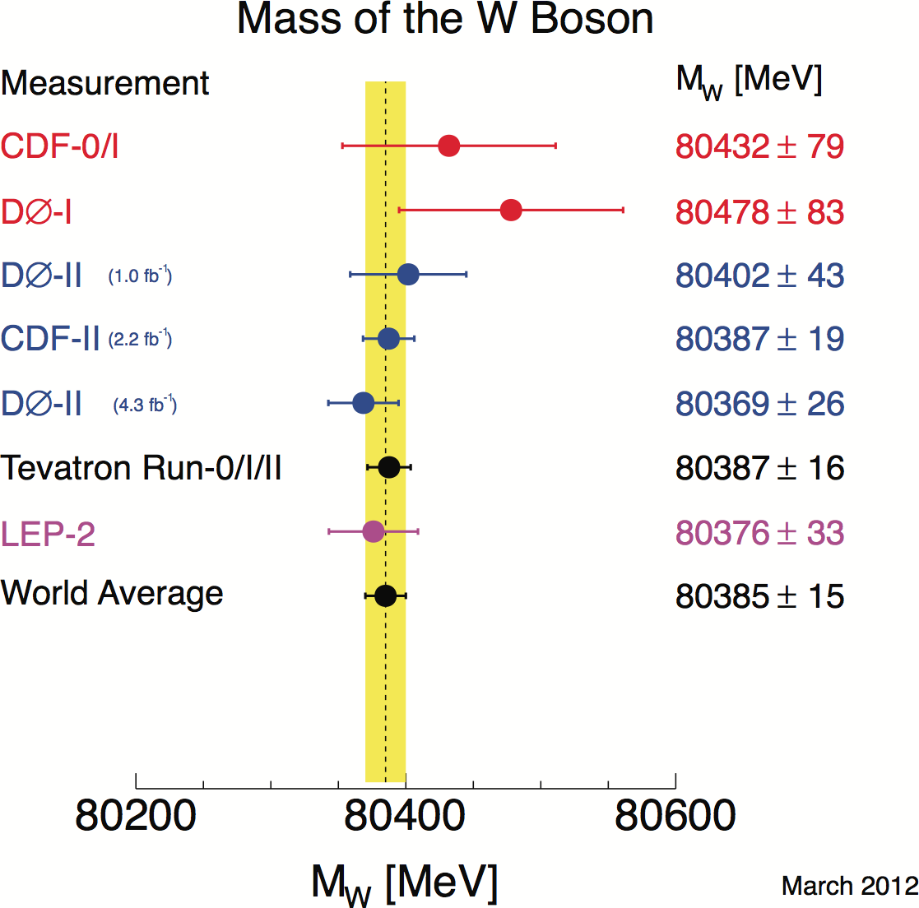
It will be hard, even with the LHC statistics, to compete with the
superb precision (~16 MeV !) obtained in the W mass measurement.

Slide 17
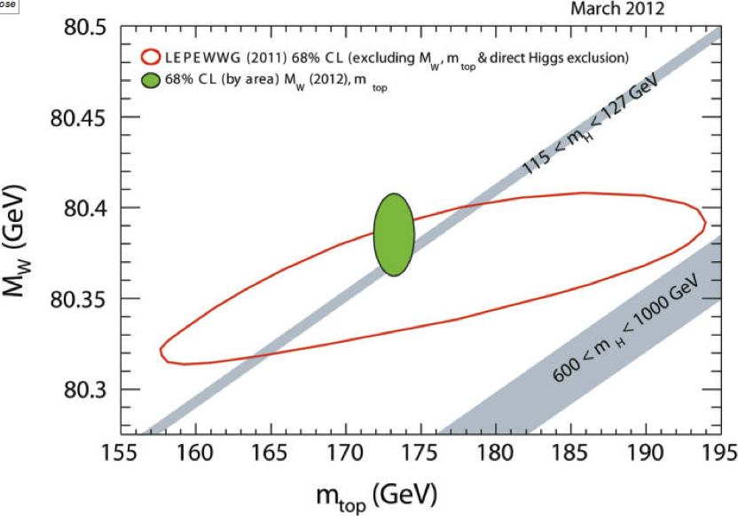
Colliders leave little space
M_{W} dominates the internal consistency tests of the Standard Model →
the Tevatron measurement will contribute in a very significant way to the full picture still for a long time, i.e. until the LHC will improve on the M_{W} precision.

Slide 18
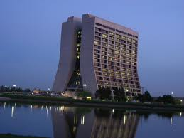
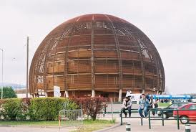
Tevatron’s main legacy to the LHC
The demonstration that a huge wealth of (superb) precision measurements can be made at hadron colliders
Advanced analysis techniques brought to full maturity. They allow tiny signals to be extracted from (often complex mixtures of) huge backgrounds, even for very small S/B (e.g. single top, potentially Higgs …)
Huge gain in sensitivity compared with expectation can be achieved with data, painstaking experimental work, and a lot of ingenuity

Slide 19
BUT most importantly . . .
The transfer of a huge amount of knowledge
and experience through members of FNAL
working on the accelerator
and
physicists from Tevatron experiments joining
ATLAS and CMS
Collaborative Competition
Competitive Collaboration
Co-opetition

Slide 20

Exciting Times
Today
• Intensity frontier
e.g. large neutrino mixing angle Ɵ₁₃
• Energy frontier
e.g. Higgs around the corner ?

Slide 21
Road beyond the Standard Model
Tomorrow
We are looking forward to
a long lasting continuation
of the strong partnership
between FNAL and CERN
We need you

