Slide 1
Fermilab
Physics for Everyone
Herman B. White
Fermi National Accelerator Laboratory
October 6, 2010
Lecture Series

Slide 2
Answers for people in the check-out line
at the Jewel grocery store
Questions?
  What do you folk do at that place/laboratory?
  How much does it cost?
  What good is the work? Will it solve any current
  problems? Energy? Health? Economy?
  What is a particle?
  What is physics?
  Do you like physics?

Slide 3
Outline
What is the universe made of?
How Fermilab became a great laboratory
Particle physics with colliding beams and fixed targets
The Frontier: FNAL, LHC
The economic impact of Fermilab
The Future: Project X and the Physics Frontiers

Slide 4
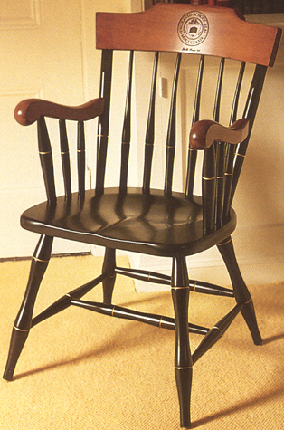
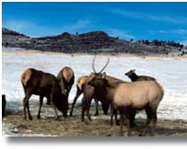
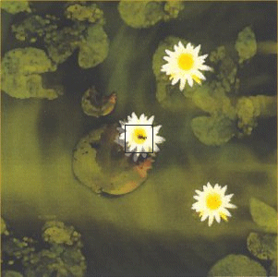

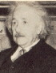
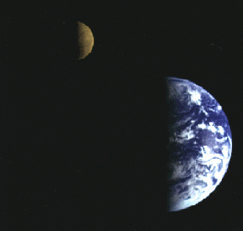
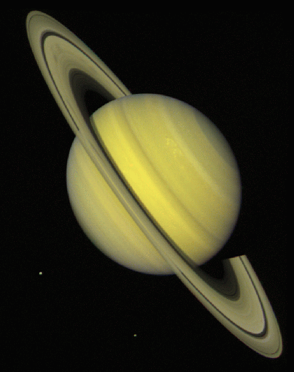
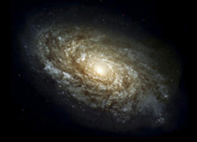
What is the Universe made of?
What are the smallest things we can study?

Slide 5


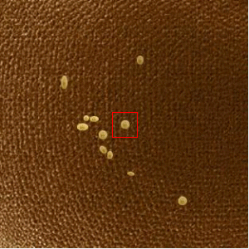

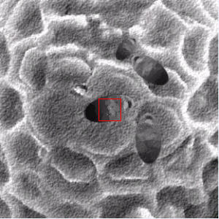
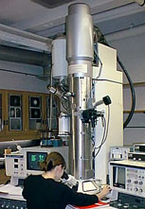
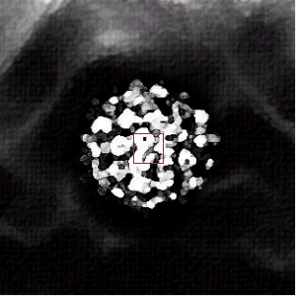
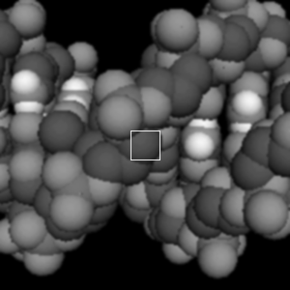
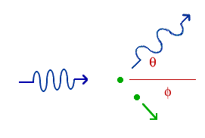
1
100
1
100
1
100
X Ray machine
1
100
atom
1
100

Slide 6
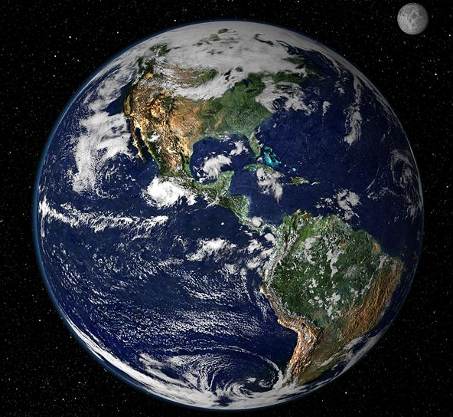
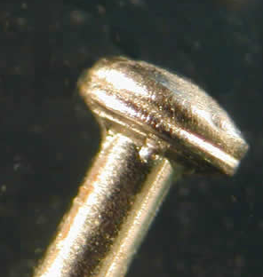
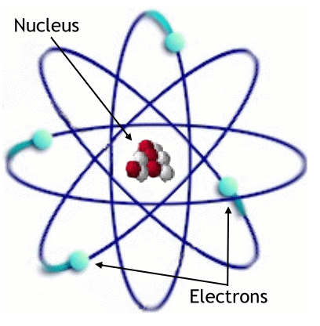
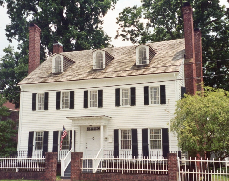
How tiny is tiny? Protons and the tinier quarks inside them:
Magnify a pinhead to
the size of the Earth:
Then an atom is about
the size of a house:
NOT
SO
BIG!
… and the nucleus the
size of a pinhead in that house!
…and we measure quarks 10,000 times smaller than that pinhead!

Slide 7












What is matter?
Particles in various combinations
Quarks
Leptons
up
charm
electron
muon
tau
top
down
strange
bottom
electron neutrino
muon neutrino
tau neutrino

Slide 8
Building a universe
electron
proton
neutron
Multiply by billions and billions and billions and billions…

Slide 9
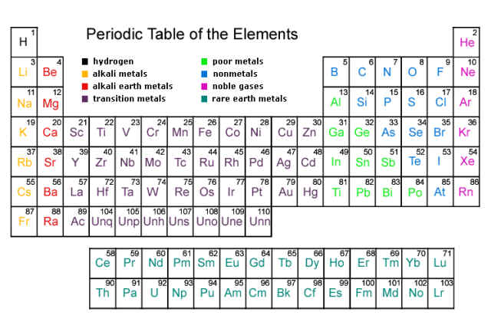
Atoms
This arises because atoms have substructure

Slide 10
Great Moments in Physics
1687 Newton formulates the Law of Gravitation
1787 Coulomb formulates the Law of Electrostatic Attraction and Repulsion
1803 Dalton's Atomic Theory
1865 Maxwell's Equations of Electromagnetism
1870 Periodic Table of the Elements
1897 J. J. Thomson discovers the "electron"
1911 Rutherford shows that the atom has a nucleus
or center, where the positive charge and most of the mass is concentrated.
1914 Rutherford discovers the "proton"
1926 Schrödinger Equation- Quantum Mechanics
1926 Quantitative understanding of atomic structure and
-1930 the emission and absorption of light by atoms.
1932 Chadwick discovers the neutron ( neutral component of the nucleus)

Slide 11
How Fermilab became a great laboratory
Fermi National Accelerator Laboratory advances the understanding of the fundamental nature of matter and energy by providing leadership and resources for qualified researchers to conduct basic research at the frontiers of high energy physics and related disciplines.
Fermilab measures the properties of matter
A little history
Accelerators act like microscopes

Slide 12
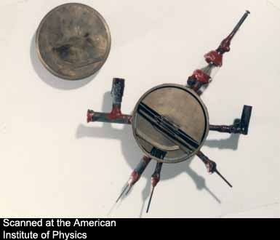
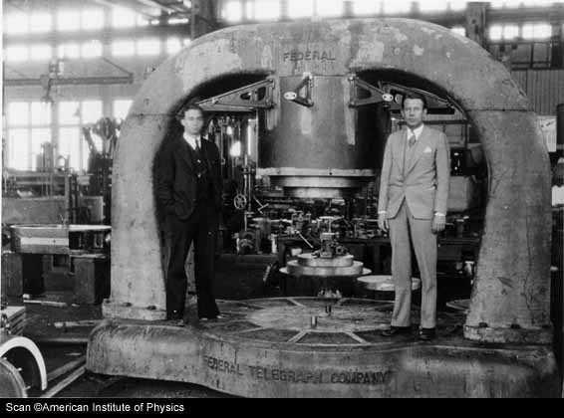
The First Accelerators
Lawrence and Livingston began developing this 4.5-inch cyclotron in 1929-30.
Livingston (left) and Lawrence with the magnet of the 27-inch cyclotron,
operating in 1932 at 3.6 MeV.
Courtesy: Adrienne Kolb, Fermilab
Notes:
Here we see the first accelerator/cyclotron (on the left), about the size of your hand. It was developed in that hot-bed of accelerator creation, UC-Berkeley, by Ernest Lawrence, shown here on the right, and his graduate student Stan Livingston, in 1929-30. Many years later Livingston worked here, in the early days of Fermilab, as an Assistant Director to Founding Director Robert R. Wilson.
L&L went on to build an even larger accelerator in 1932, shown here on the right. You’ll begin to recognize a pattern…accelerators kept growing to reach ever-higher energies. As they grew larger and more powerful they were given grand names like the Cosmotron and the Bevatron.

Slide 13
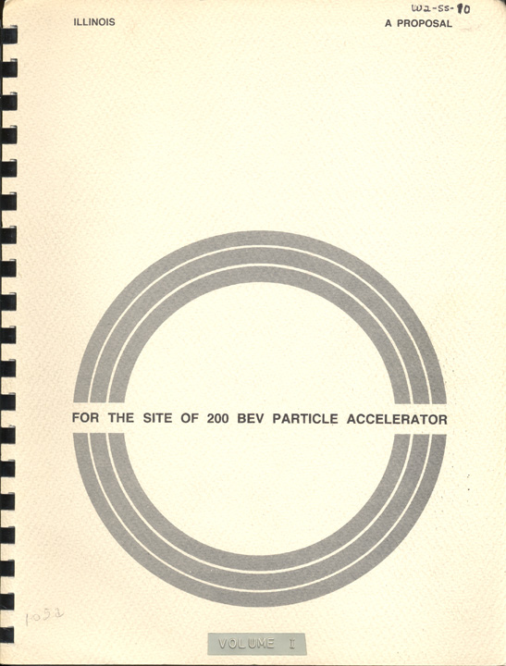
Illinois Proposal for 200 BeV Accelerator 1965
Courtesy: Adrienne Kolb, Fermilab
Notes:
In 1965 the state of Illinois submitted its proposal to build the NAL at a site called “Weston.”

Slide 14
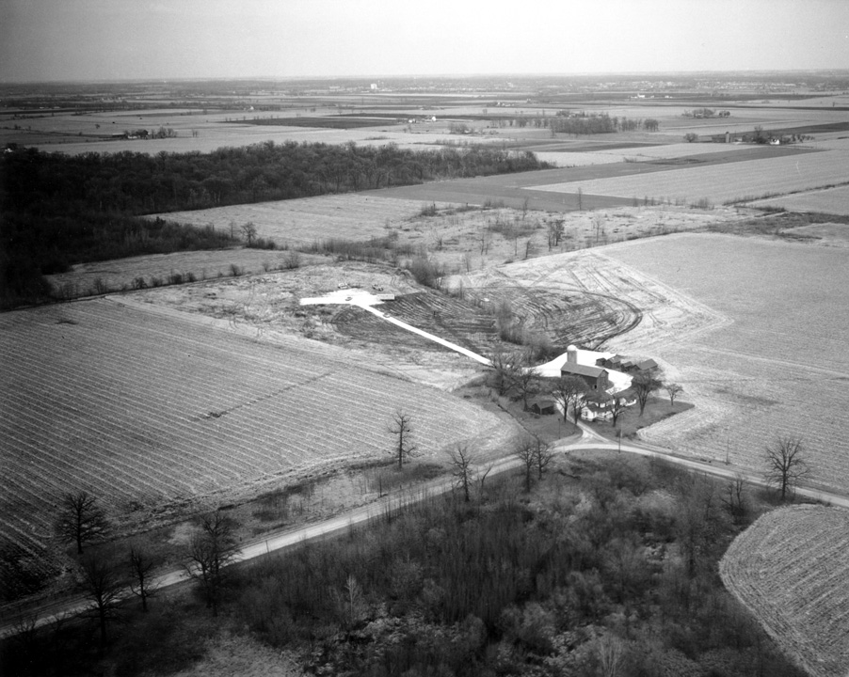
The Weston Site
Courtesy: Adrienne Kolb, Fermilab
Notes:
It included 6,800 acres of farmland, which in 1962 was owned by 56 different families and several banks. The Big Woods forest on the western side was also part of the proposed site and … the reason it was all called “Weston” was because of a subdivision on the eastern side…

Slide 15
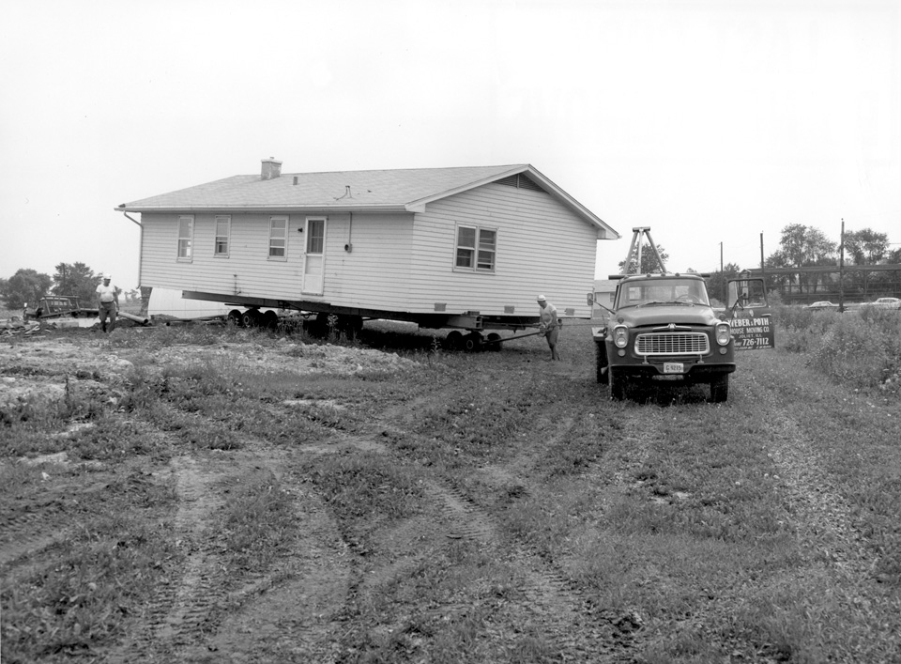
Reconstructing Weston
Courtesy: Adrienne Kolb, Fermilab
Notes:
The Weston houses were converted into Lab offices, and moved around as needed…

Slide 16
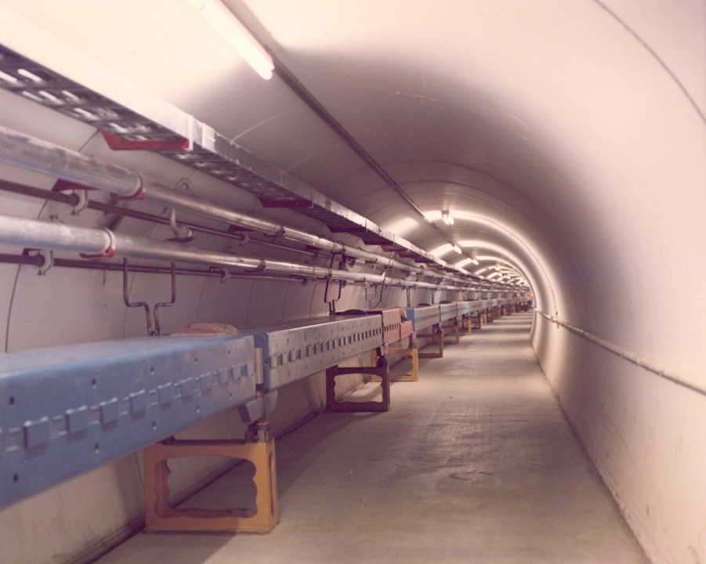
The Main Ring
Notes:
The Main Ring was completed in 1971.

Slide 17
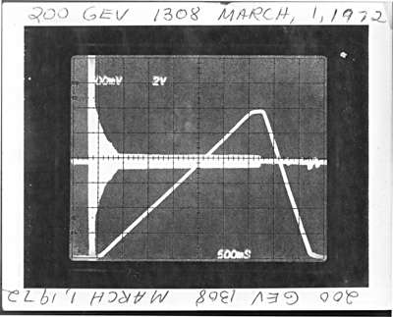
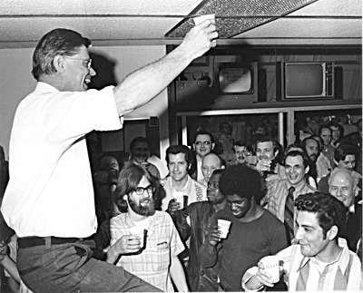
200 GeV March 1, 1972
Wilson toasts the NAL staff
Notes:
Success! 200 GeV was achieved on March 1, 1972!
Wilson celebrated with those whose hands, minds, and hearts had done the job, opened the door and cleared the path for exploration of the physics frontier.

Slide 18
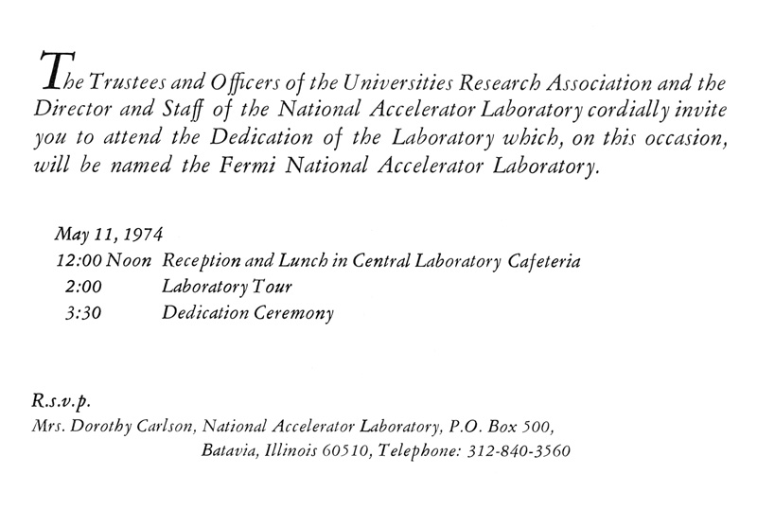
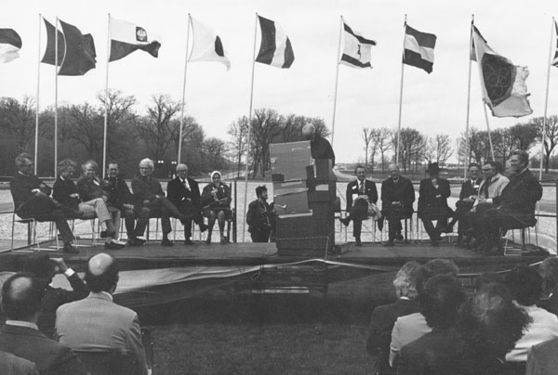
Dedication of Fermi National Accelerator Laboratory May 11, 1974
Courtesy: Adrienne Kolb, Fermilab
Notes:
The Laboratory was dedicated on a cold day in May, 1974, and the name was changed to Fermi National Accelerator Laboratory. Enrico Fermi’s wife Laura attended the Dedication and recalled her husband’s hopes for accelerators. Leon Lederman, representing the Users, gave the dedication address and played a tape recording of Fermi’s voice, but I’m told the weather was so windy that day, a rainstorm like our recent storms had just blown through the area, and hearing Fermi’s voice was quite a challenge.

Slide 19
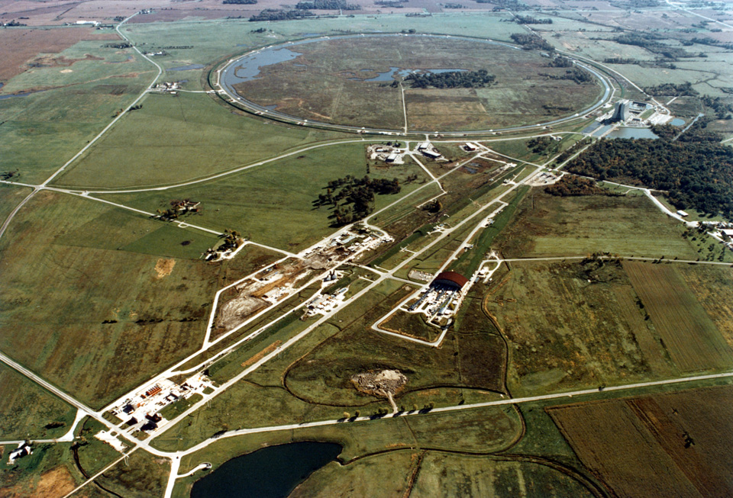
Fermilab, 1977
Notes:
By 1977 Fermilab’s Main Ring and its Fixed-target Experimental Areas were a whole facility. The Main Ring’s performance benefited from inventions and innovations allowing the energy to rise from 200 GeV to 400 GeV, to compete with CERN even without the Energy Doubler.
You may notice a small line of trees along Eola Road in this picture, evidence of the early “greening” of the site. Today these trees are fully grown and tower over the road. A few farm sites remained on their original foundations, but by this time they had mostly different uses.

Slide 20
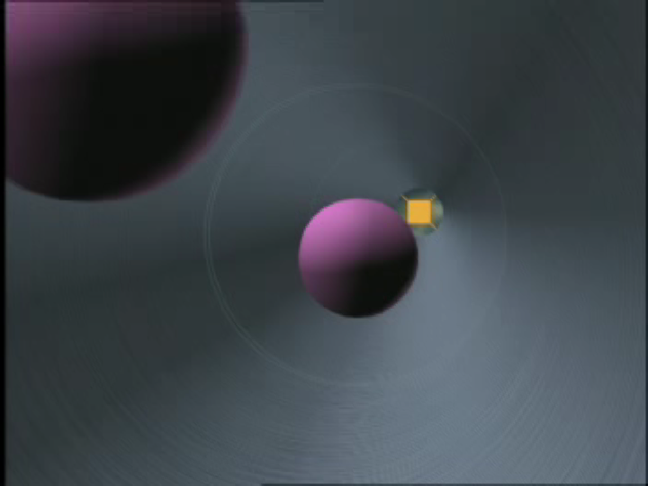

Slide 21
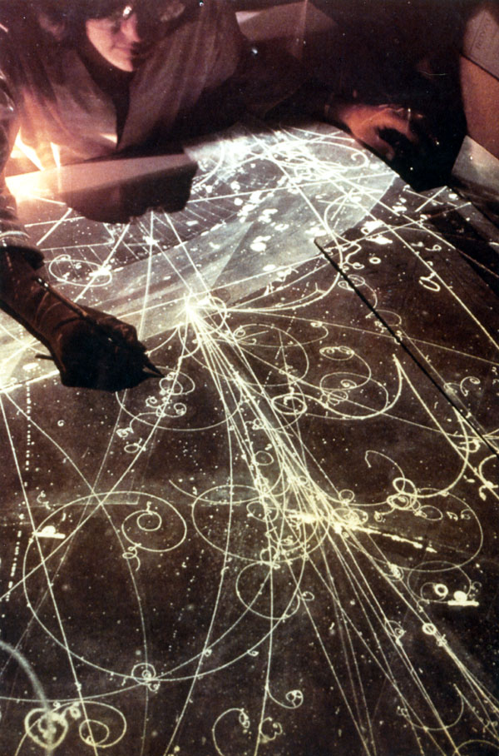
Before electronic data analysis, individuals visually examined photographs of Bubble Chamber particle interactions.
Notes:
…sometimes straining their eyes in search of new particles….

Slide 22
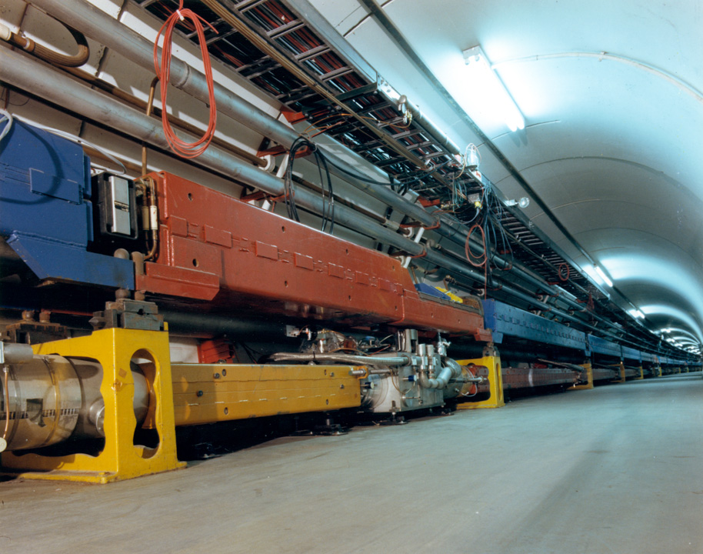
Energy Doubler/Saver
Notes:
Lederman immediately set Fermilab’s course for convincing the DOE to build the Energy Doubler/Saver in the Main Ring, securing funds in 1979. The accelerator complex was renamed the Tevatron, because the attainable energy level would be close to 1,000 BeV = 1 TeV, trillion electron volts.

Slide 23
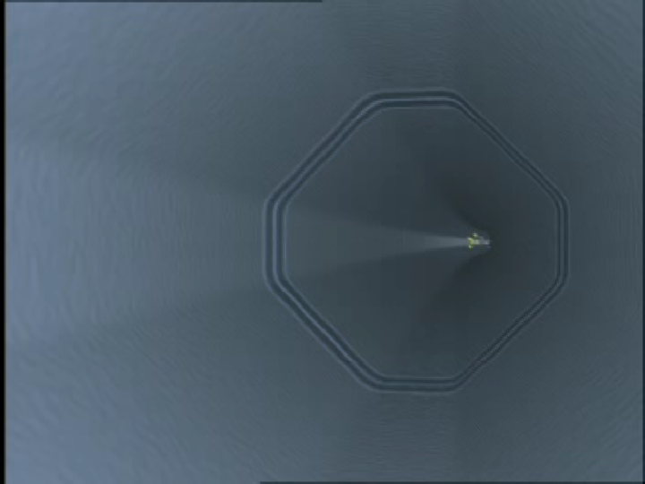

Slide 24
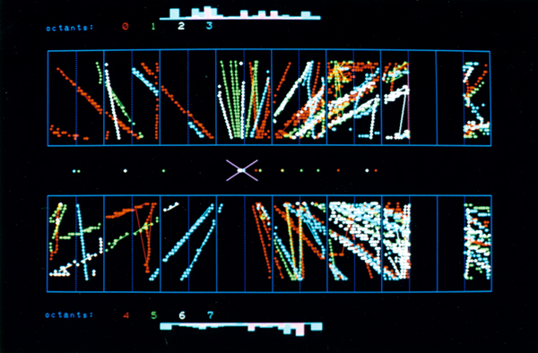
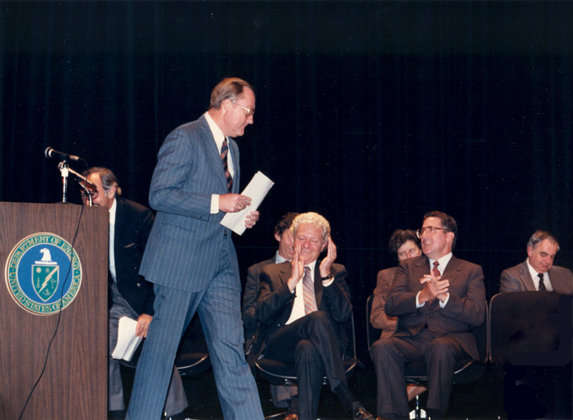
First Collisions October 13, 1985
Dedication of the Tevatron Collider October 11, 1985
Notes:
The first collisions meant greater discovery potential for Fermilab researchers working at the highest energy in the world.

Slide 25
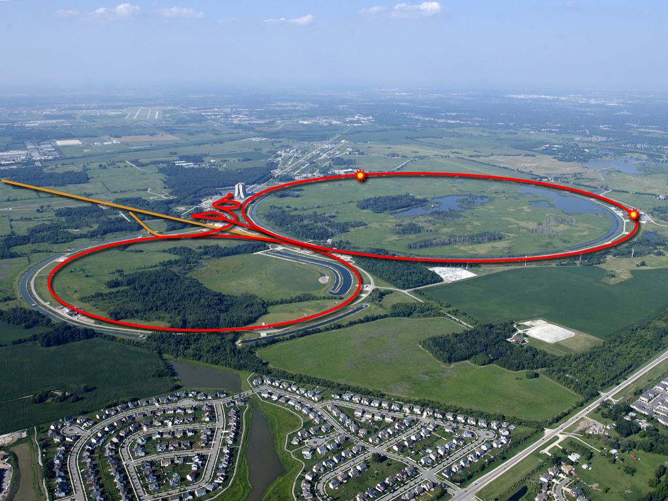
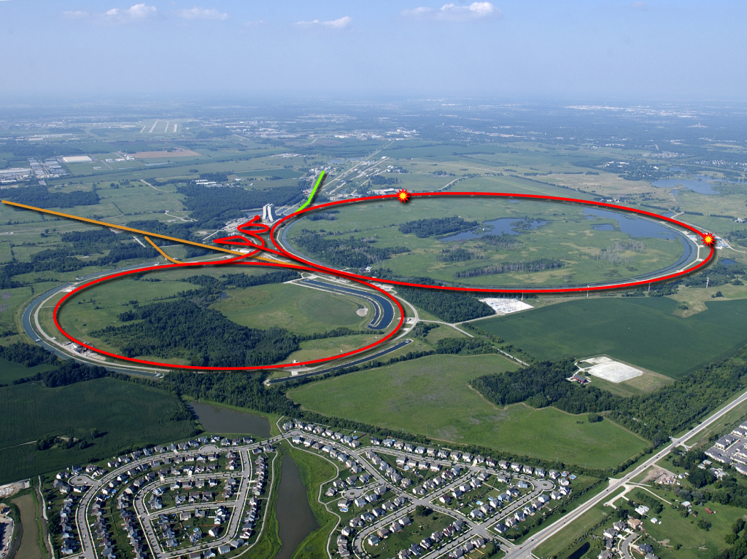

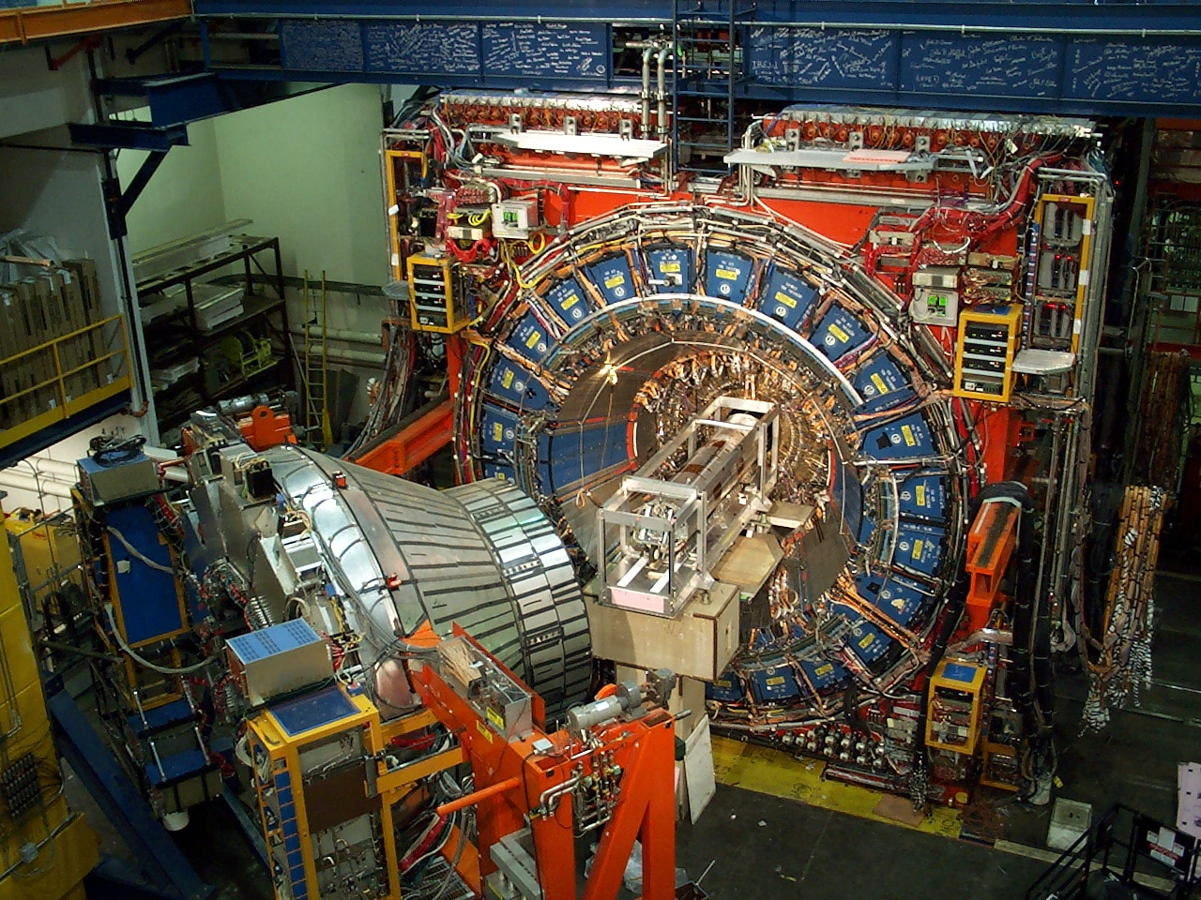
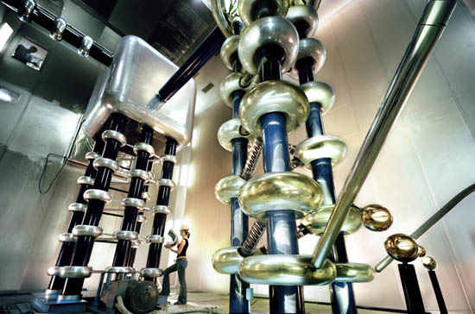
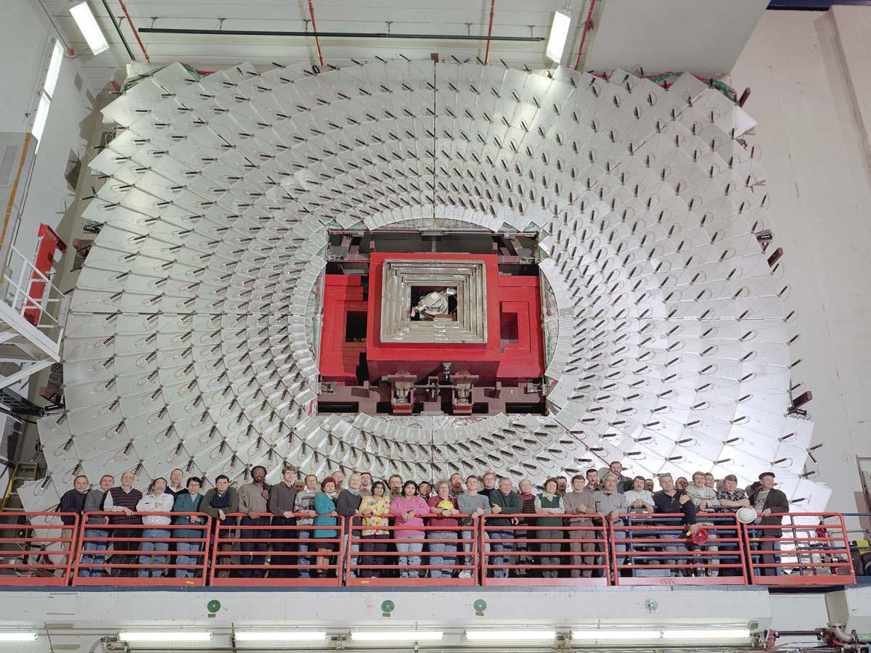
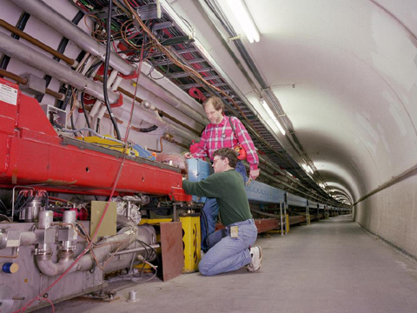
Accelerators – powerful tools for particle physics
CDF Experiment
We make high energy particle interactions
by colliding two beams heads on
2 km
DZero Experiment

Slide 26
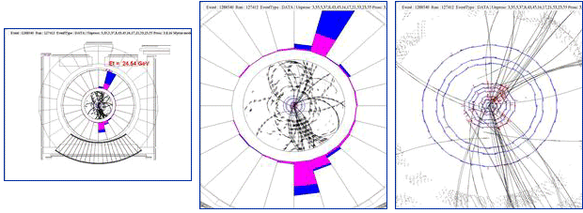
An Event Picture
Dec 3, 2001
End view of the
entire CDF detector
Close-up showing
tracks + energy
Close-up showing
tracks with hits in the silicon system
Courtesy: William Wester, CDF

Slide 27
P5
Notes:
27

Slide 28
The Energy Frontier: LHC and the Tevatron
Energy difference of a factor of ~ 7 in the future
Search for elusive particles and tests
Train new scientists
Develop new techniques, machines, and detectors at high energies

Slide 29
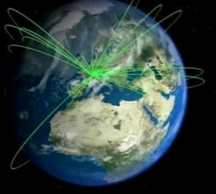
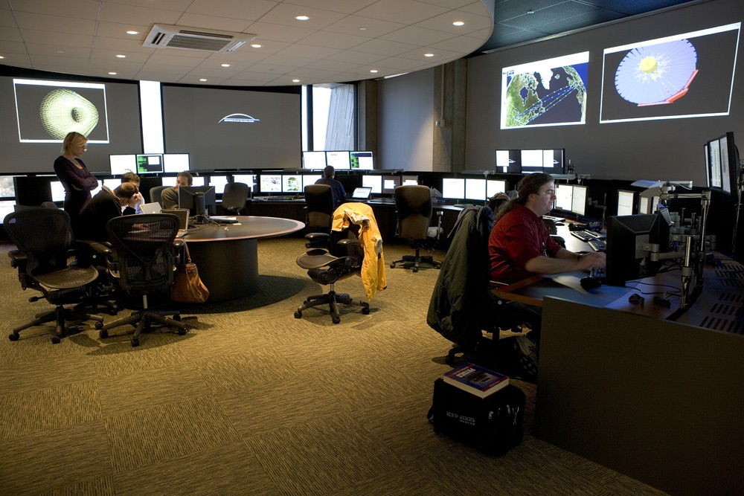
The Energy Frontier: CMS
CERN
Fermilab
Remote Operation Center (ROC):
Accelerators and Detectors Monitoring
Tier-1 Comp. Center, LHC Physics Center:
Support the US CMS Community

Slide 30
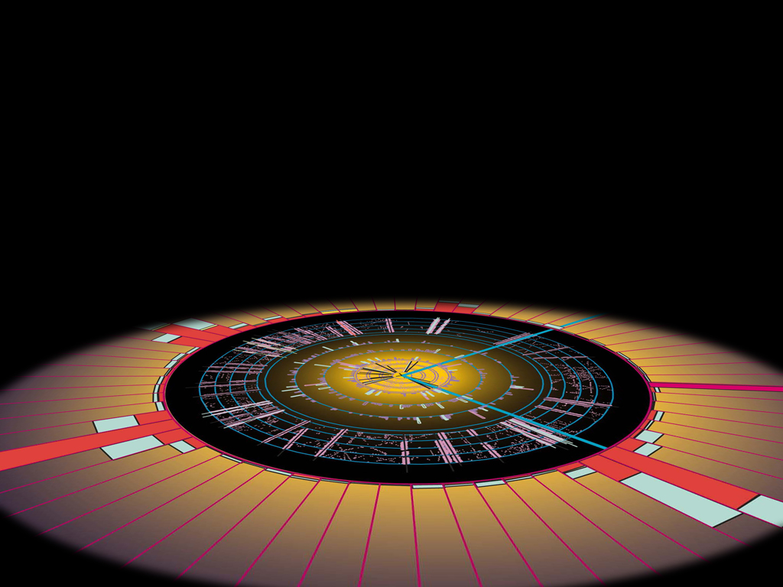
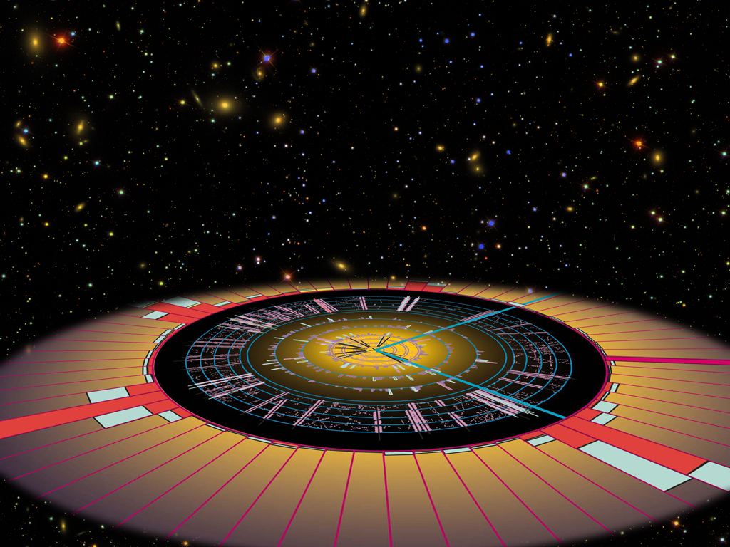
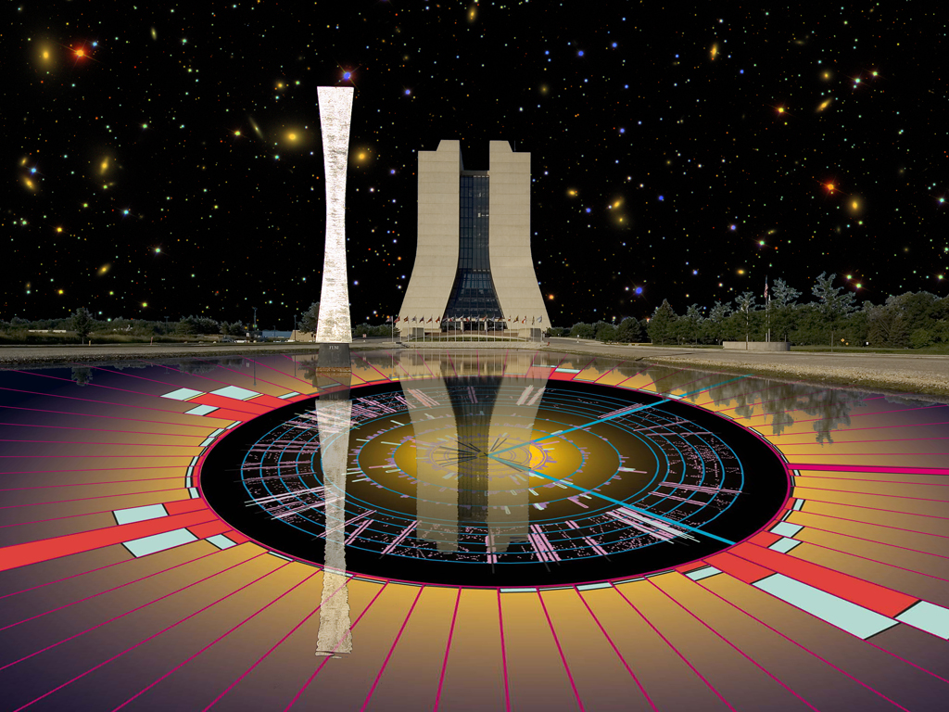
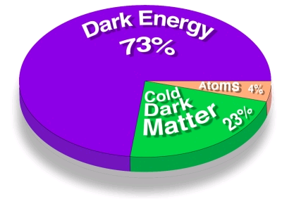
The Cosmic Frontier: Quarks to Cosmos
Dark Matter
Dark Energy
Ultra High Energy Cosmic Rays
30
Young-Kee Kim: Ten Year Plan (Science and Resources), PAC Meeting 2009-03-05
Notes:
30
30

Slide 31
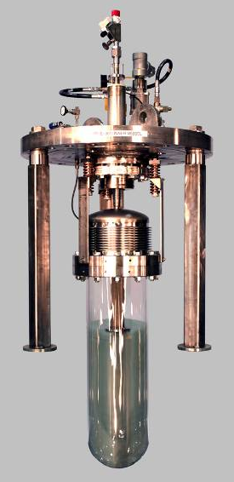
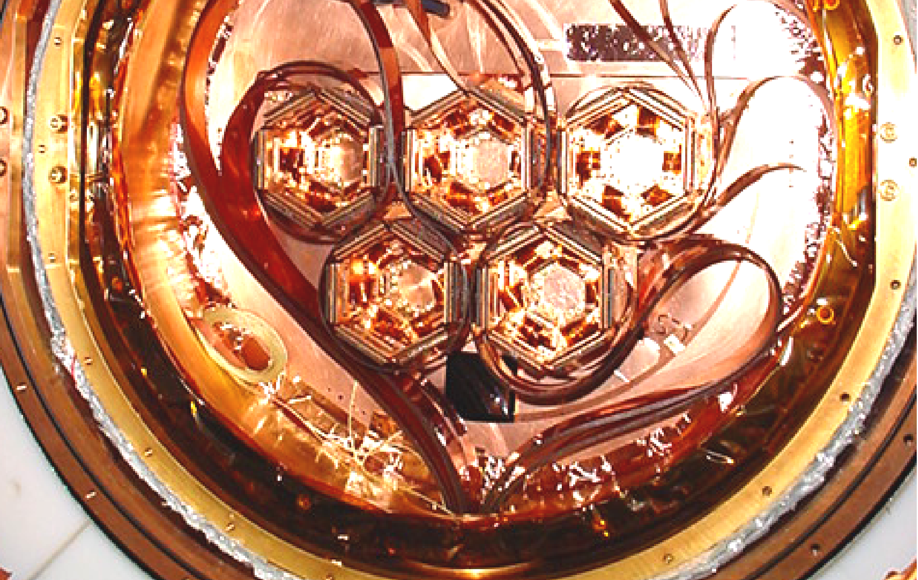

Underground Dark Matter Detectors
COUPP
60 kg / 30 liter
CDMS
Low temperature crystals
4 kg
→ 15 kg
2 kg / 1 liter
COUPP
Room temperature bubble chamber
Notes:
31
31

Slide 32



Probing Dark Energy
SDSS
DES
JDEM
SDSS (Sloan Digital Sky Survey)
  2.5 meter telescope in New Mexico
  Ranks as the facility with the highest impact on astronomy for the 3rd year in a row.
  Power spectrum of galaxies constrain dark energy density parameter.
DES (Dark Energy Survey)
  4 meter telescope in Chile
  DES Camera: CD-3a on Apr. 29, 2008
  CD-3b on Oct. 24, 2008
  Operation: 2011 – 2016
JDEM (Joint Dark Energy Mission)
  Space telescope
  Fermilab Goal: Science Operation Center

Slide 33


Outer Space
Astrophysics
Sloan Digital Sky Survey
Pierre Auger Observatory
Notes:
Fermilab’s pursuits of outer space with experimental astrophysics projects like the Sloan Digital Sky Survey and the Pierre Auger Observatory, help to keep Fermilab at the leading edge of the cosmic frontier.

Slide 34



Intensity Frontier: neutrinos now
Minos Far Detector

Slide 35
The Intensity Frontier
17 kW at 8 GeV
for neutrinos
Soudan
MiniBooNE
SciBooNE
MINOS
Tevatron Collider
250 kW at 120 GeV
for neutrinos
35
Young-Kee Kim: Ten Year Plan (Science and Resources), PAC Meeting 2009-03-05

Slide 36


NUMI – Neutrinos at the Main Injector
735 km long beam, right through
the earth! 10 km deep

Slide 37

Future Planning for Fermilab
NOvA
MINOS
NSF’s proposed
Underground Lab
DUSEL
735 km
1300 km
ν
Project X
Notes:
37

Slide 38

Project X

Slide 39


Muon to Electron Conversion

Slide 40



Slide 41


Slide 42
Fermilab:
  6,800 acres of mostly open land.
  A federally funded research facility part of the U.S.
  Department of Energy that is managed and operated by
  Fermi Research Alliance, LLC.
  A vital part of the Kane and DuPage County communities
  and of the growing northeastern Illinois economy.
  Employs ~ 1,912 people and hundreds of subcontractors.
  Provides research facilities for ∼ 2,500 particle physicists
  including students.
  Hosts thousands of visitors each year, who take
  advantage of educational, recreational and cultural
  opportunities.

Slide 43
Long-term Benefits:
  Knowledge is the foundation of future technology
  Technology drives economic growth
  Fundamental Research → Innovation → Prosperity
  Particle physics research produces transformative
  discoveries and contributes positively to the health of
  our national scientific structure.
  Examples:
    Faraday’s experiments on electricity → electric light
    H E P communication needs → World Wide Web
    Superconducting wire → new machines

Slide 44
  Cost and benefits of public investment have been shown to be a positive outcome as suggested in The National Academy Study: Rising Above the Gathering Storm: Energizing and Employing America for a Brighter Economic Future (The National Academies Committee on Science, Engineering and Public Policy, National Academies Press, 2005).
Near-term (~ our lifetimes):
  Employment
  Procurement
  Technology Transfer, Knowledge Transfer

Slide 45
FY 2009 Statistics:
  Employment ~1,912 employees, not including subcontractors
  Payroll $141M + $43M fringe = $184M
  IL income tax $4.1M withheld (CY 2009)
  Approximate employment mix by job categories:
    Administrative & Clerical 280
    Computer Professionals 284
    Engineers, Engineering Physicists 298
    Scientists 365
    Technicians, Technical Specialists 465
    Drafters, Service Workers, Skilled Trades 220
      Total 1,912
      (473 employees with PhDs)

Slide 46

The Economic Impact of Fermilab
- Where Employees Live - (2003)

Slide 47


Slide 48
FY 2009 Statistics:
  Total number of users 2,090
  Number of Illinois users:
    Academic 350
    Industrial 20
  Total number of students involved in:
    Activities at Fermilab 18,730
    Outreach activities (classroom visits) 12,918

Slide 49
Benefits of Fermilab Research
Increase our understanding of nature
and how it works
Technological spin-offs – much of today’s economy is based on late 1800s – early 1900s research on the electron →
TV (accelerator) & communications
Some examples from Fermilab & HEP will be presented in future lectures in this series

Slide 50
DISCOVERY
Extracting and understanding a phenomena for the first time!
Leading to answers and often more questions
Usually a piece of a puzzle that took some time to ascertain
Often connecting many separate fields of study
Enjoyment!

Slide 51
Conclusions
We continue to smash the nuclei that make up our universe and everyday we learn something new!
The Frontiers may merge at some point so
We Should Go Boldly into the Next Frontier

