Slide 1
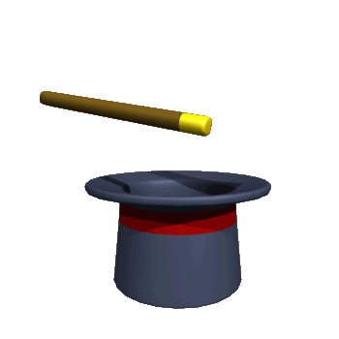
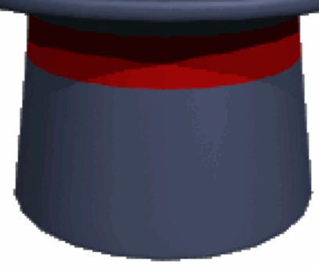

The Magic of Muons
…
μ
Physics for Everyone Lecture Series
Fermi National Accelerator Laboratory
May 4, 2011
Chris Polly, Fermilab

Slide 2
μ
What are muons?
What are they good for?
Why are they important to Fermilab?

Slide 3
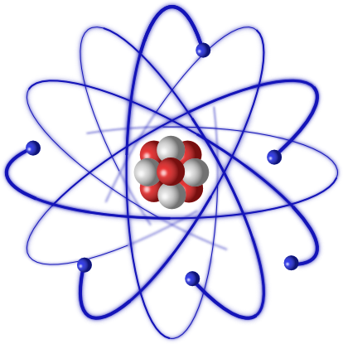
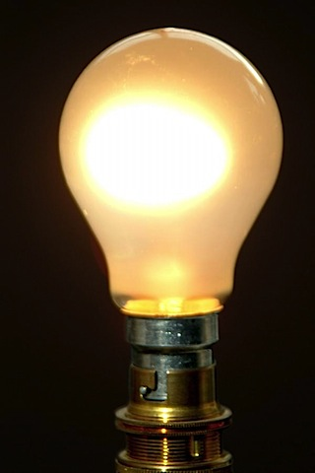
Everything we see, hear, or touch arises from a very basic set of ingredients…
p
protons
n
neutrons
e
electrons
γ
photons (light)

Slide 4
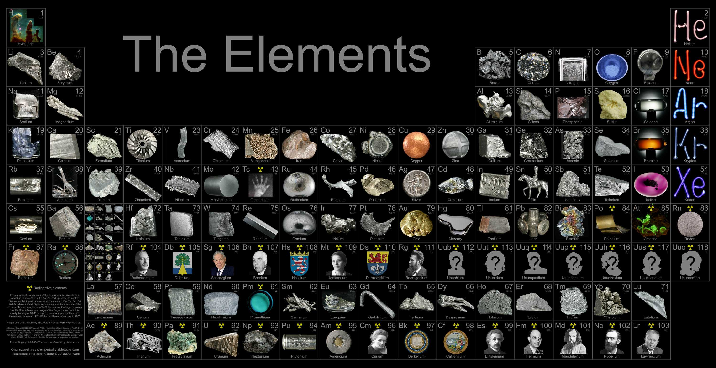
Amazing variety from such simple ingredients

Slide 5
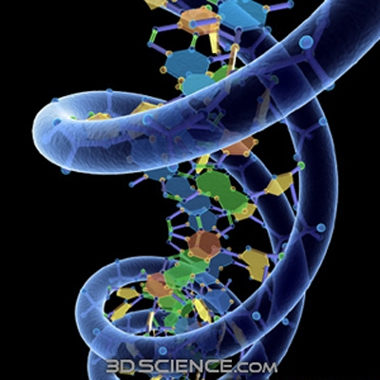
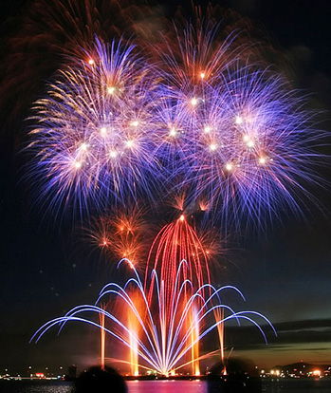
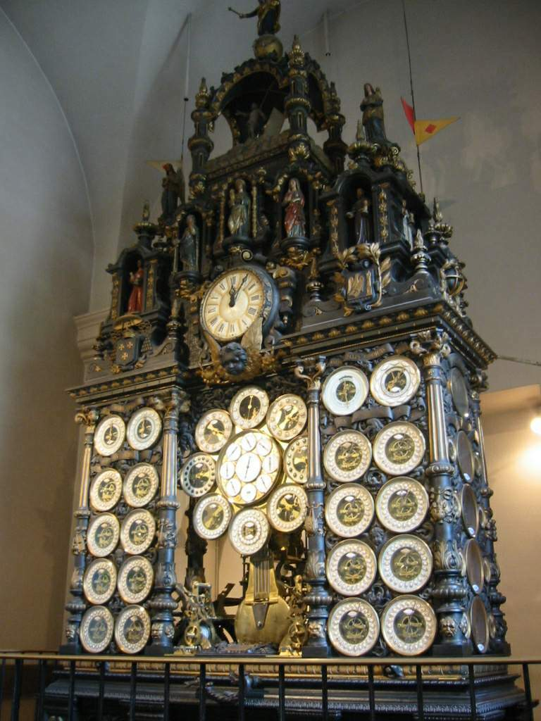
biological
And spectacular complexity…
chemical
mechanical

Slide 6
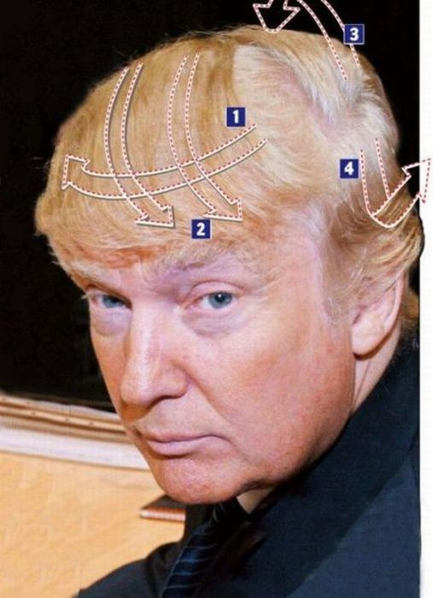

And some not so spectacular effects…

Slide 7
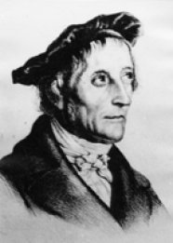
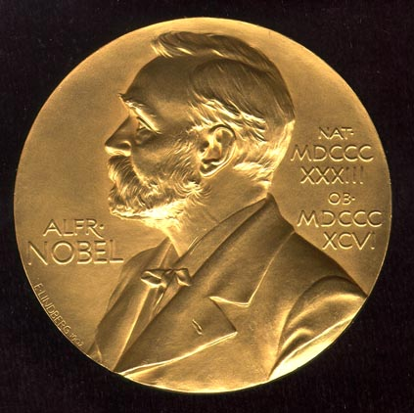
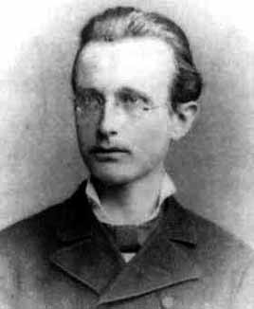
With so much of the world described by atoms & optics, some scholars at the end of the 20th century were jaded
p
protons
“In this field, almost everything is already discovered, and all that remains is to fill a few unimportant holes.” (1878) Johann Philipp Gustav von Jolly advising Max Planck not to pursue physics
n
neutrons
e
electrons
1918
γ
photons

Slide 8
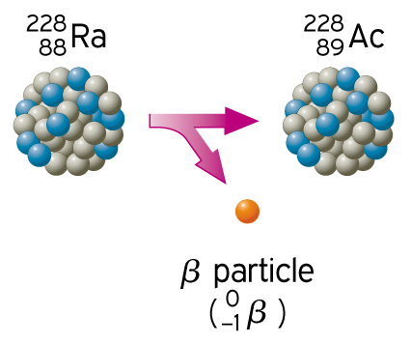
After these…muons were the next discovered in 1936
One caveat
p
protons
n
neutrons
e
electron
electrons
Radioactive decays in the 1920s appeared to violate energy conservation?!
γ
photons

Slide 9
After these…muons were the next discovered in 1936
One caveat
p
protons
n
neutrons
e
?
electron
electrons
Postulated in 1930, but not directly observed until 1956
To solve the conundrum, Pauli proposed a phantom particle…the neutrino
ν
neutrinos
γ
photons

Slide 10
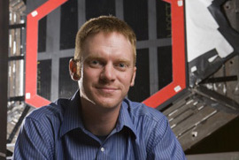
Neutrinos are fascinating and play a huge role in FNAL’s past, present, and future
p
protons
n
neutrons
e
electrons
ν
neutrinos
Physics for Everyone Lecture Series
David Schmitz, Fermilab
April 6, 2011
γ
photons

Slide 11

Muons discovered in a rather unlikely place!
Pike’s Peak, CO

Slide 12
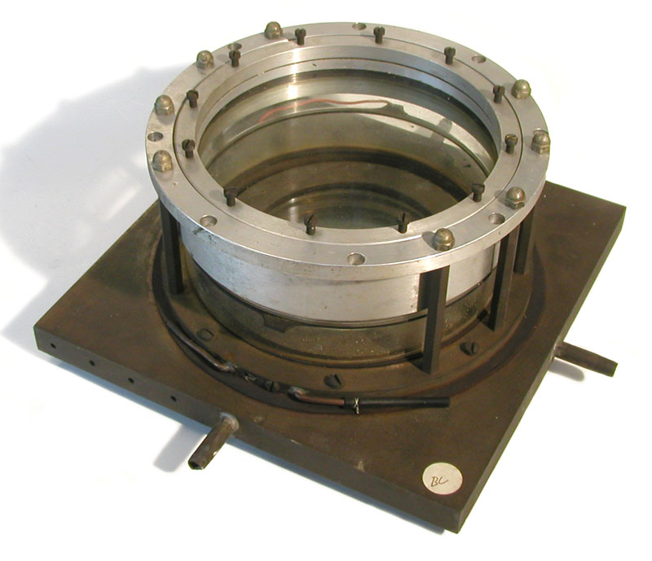
Muons discovered in a rather unlikely place!
Pike’s Peak, CO
circa 1936 cloud chamber

Slide 13
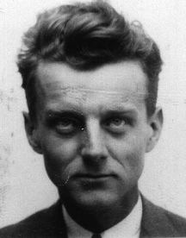
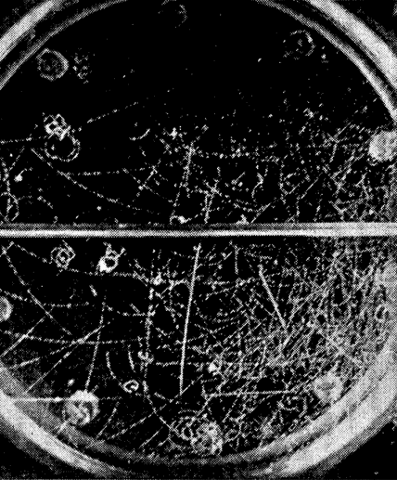
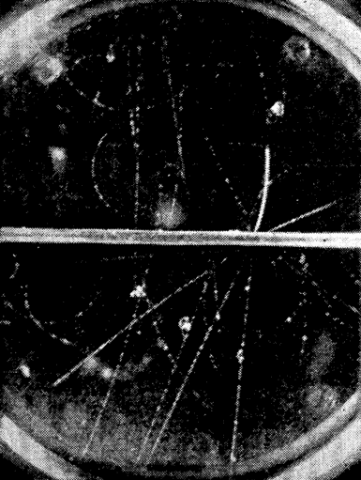
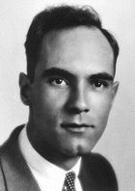
Seth Neddermeyer
Can you spot the muon in these original cloud chamber photos?
Hint…they make thicker tracks
Carl Anderson
1936

Slide 14
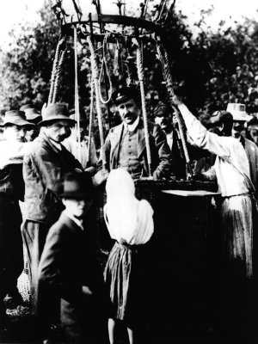
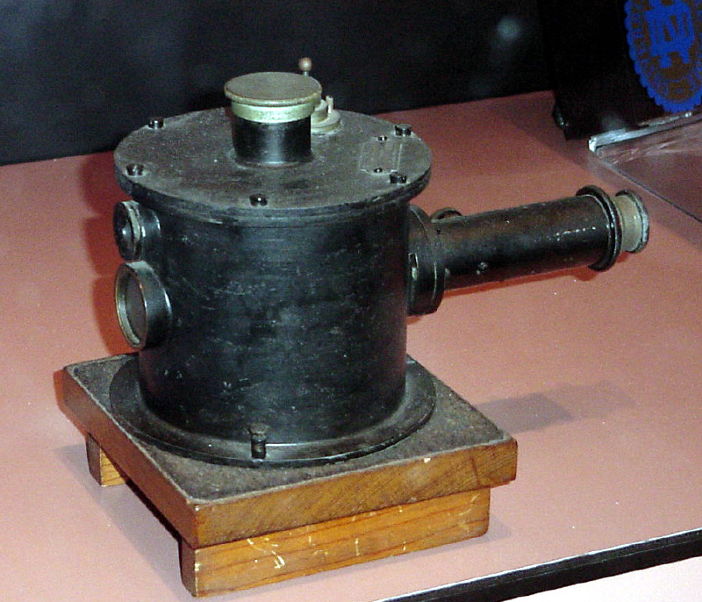
Why would they want to take their state of the art equipment to the top of a mountain?
Victor Hess
To get closer to the source!
1911-13 electroscope
1936

Slide 15
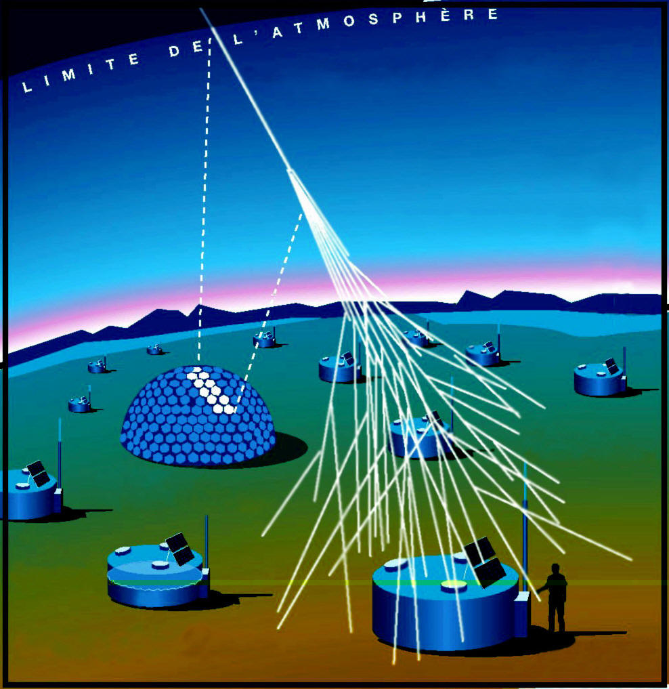
Cosmic ray research is very active today
Most energetic particle interactions ever observed…where do they come from?
Fermilab astrophysics group heavily involved in Auger observatory in Argentina (1200 sq. miles)

Slide 16
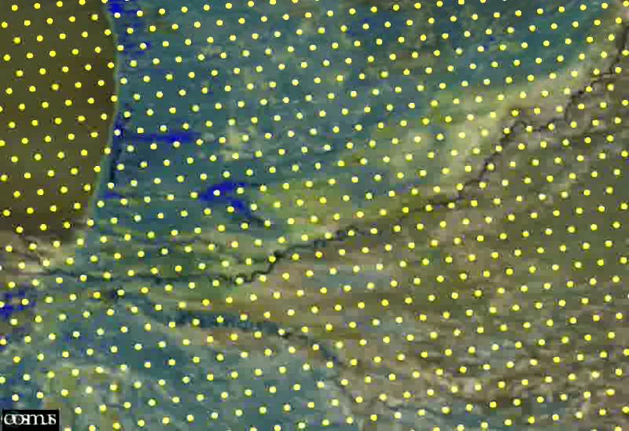
Simulation of cosmic ray event in Auger
electrons
muons

Slide 17
Simulation of cosmic ray event in Auger
electrons
muons
Auger uses muons produced in cosmic ray interactions to study the cosmic ray interactions themselves!

Slide 18
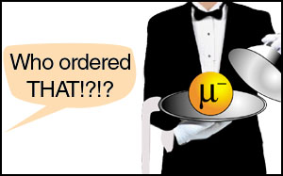
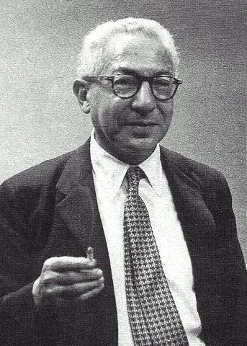
μ
What are muons?
Physicists in 1936 were
just as puzzled
I. I. Rabi
1944

Slide 19

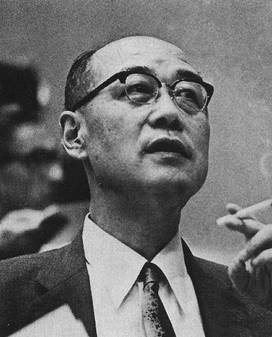
And then a major case of mistaken identity ensued
p
n
e
?
Hideki Yukawa
ν
Predicted the existence of a particle that allowed protons and neutrons to communicate. Called it the meson (Greek “mesos”: intermediate)
Anderson’s muon even had the correct mass as predicted by Yukawa
γ
Called it the “mu-meson”
1949

Slide 20
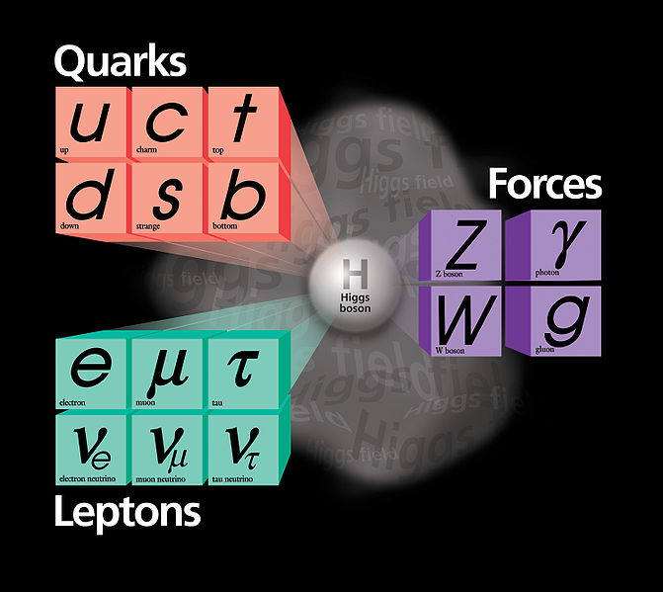
We now know Yukawa’s particle does exist and we call it a “pion or pi-meson”
p
π
n
pions
In fact, we know much more…protons, neutrons, and pions are really composed of more fundamental “quarks”!

Slide 21
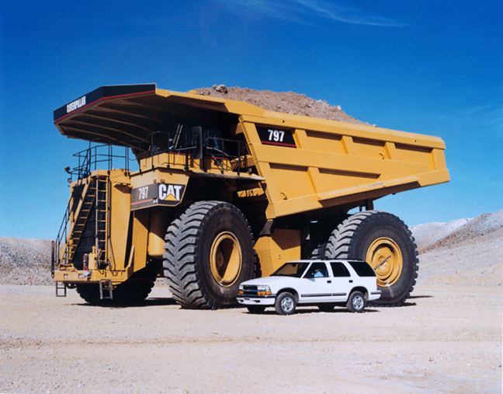
p
What are muons?
π
As far as we can tell they are exactly like electrons…only 200 times heavier
n
muons
e
μ
ν
γ

Slide 22
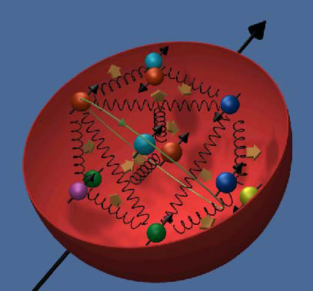
Muon/electron similarities
p
π
Fundamental…don’t seem to be made of parts like protons, and neutrons…no spatial extent
n
muons
e
μ
Protons made of stuff
ν
γ

Slide 23
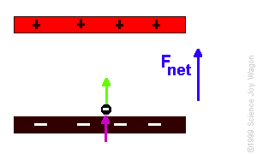
Muon/electron similarities
p
π
They have the same electrical charge
n
muons
e
μ
ν
γ

Slide 24
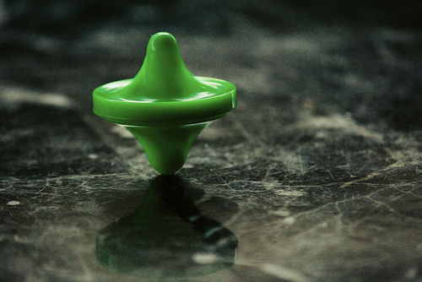
Muon/electron similarities
p
π
They both have spin
n
muons
e
μ
ν
γ

Slide 25
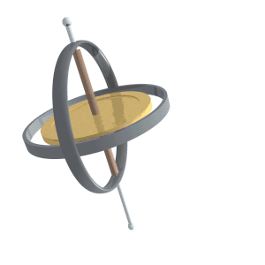
Muon/electron similarities
p
π
Spin precession in a magnetic field
n
muons
e
μ
ν
γ

Slide 26
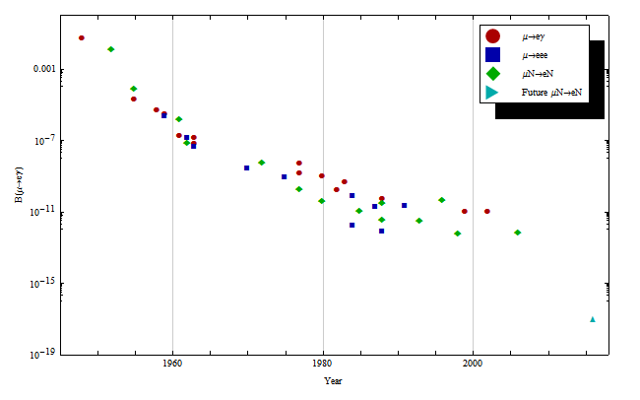

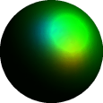
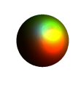
In fact, they were so similar, scientists wondered if muons were electrons in some excited state
p
γ
μ
e
Level at which muons convert to electrons
e⁻
Year

Slide 27
Where do muons come from?
p
π
n
muons
e
μ
ν
γ

Slide 28

Where do muons come from?
p
π
Ironically, we mainly make them via Yukawa’s pions
n
muons
e
μ
ν
μ
p
π
ν
γ

Slide 29
Where do they go?
p
π
n
muons
e
μ
ν
γ

Slide 30
Where do they go?
p
π
They only live 2 millionths of a second before they decay
n
muons
e
μ
ν
μ
e
ν
ν
γ

Slide 31
μ
What are they good for?
Muon spin resonance
Muon radiography
Muon catalyzed fusion

Slide 32

Muon spin resonance…two principles
Highest energy decay electrons are emitted in spin direction
μ
e
ν
ν
Imagine putting a bunch of
muons in the same field
Muon precession faster in stronger magnetic field

Slide 33
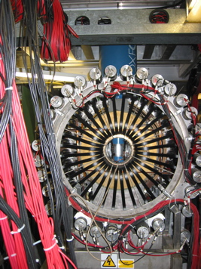
So by measuring how fast the electron beam rotates, the local magnetic field can be determined
Muon Spin Resonance
Setup at ISIS
Lots of applications for understanding magnetic fields/physics in materials:
-magnetoresistance
-semiconductors
-superconductor
-ion mobility
-many, many more possibilities

Slide 34
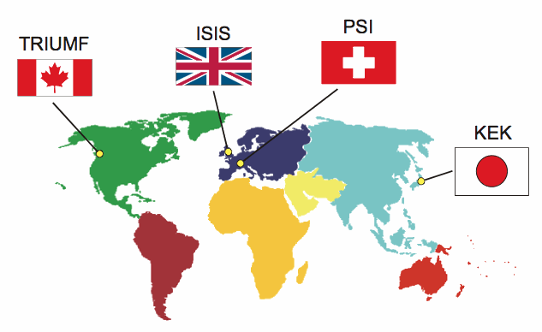
Where are the facilities that do this?

Slide 35
μ
What are they good for?
Muon spin resonance
Muon radiography

Slide 36
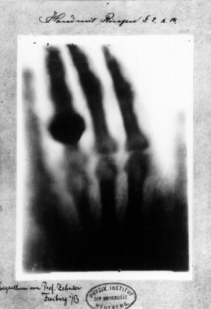
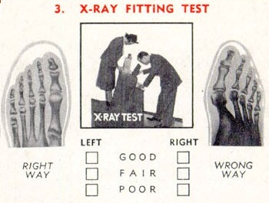
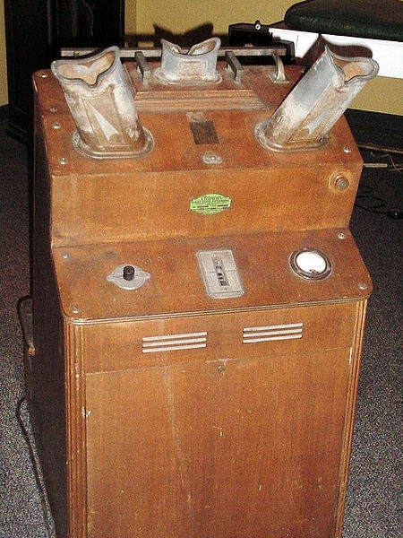
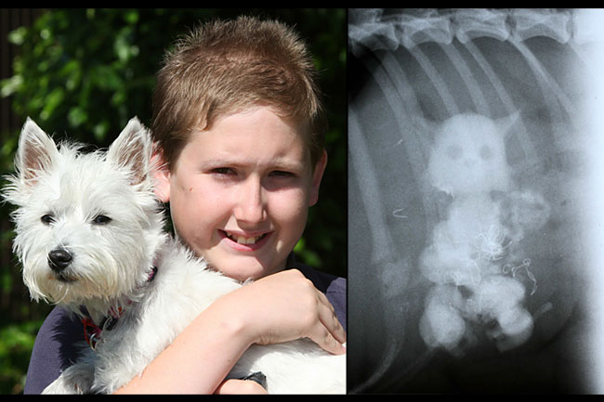
Muon radiography
Everyone here is familiar with X-ray radiography
Does anyone know what this is?
..a shoe-fitting fluoroscope
Has anyone seen the cat?
First X-ray 1895…hand of Wilhelm Rontgen’s WIFE

Slide 37
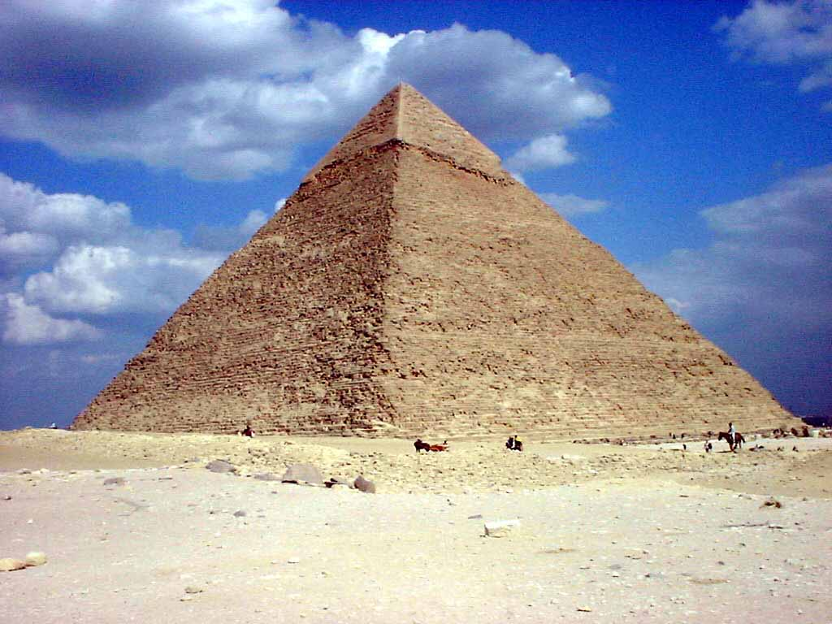
Muon radiography…why use muons?
Very penetrating…can X-ray LARGE items
How large?
Penetrating enough to X-ray a Gisa pyramid in a quest for secret chambers
Chephren’s pyramid in Gisa

Slide 38
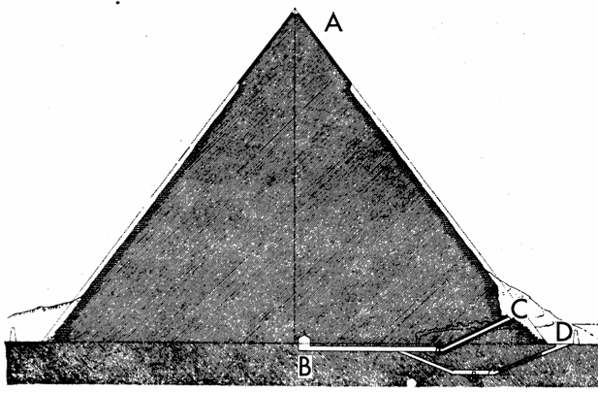
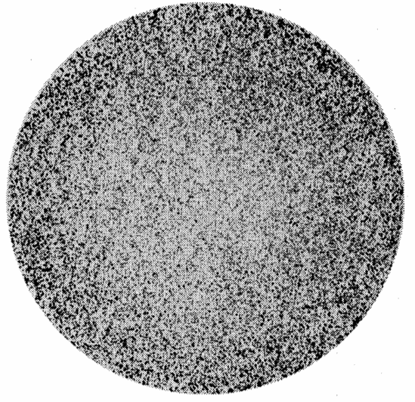
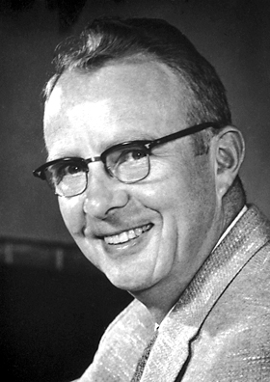
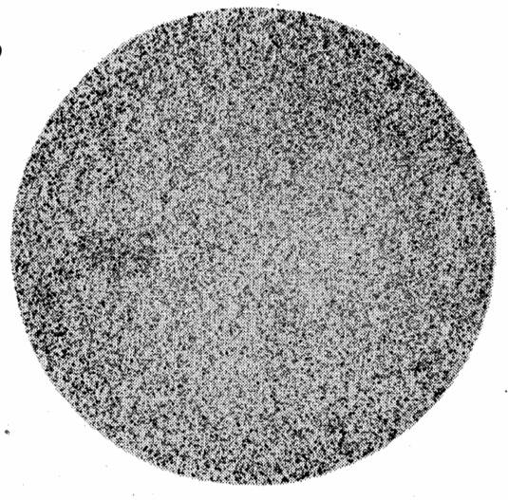
Muon radiography
Data acquired
Luis Alvarez
Simulated data with chamber
Alvarez installed his detector in this chamber
1968

Slide 39
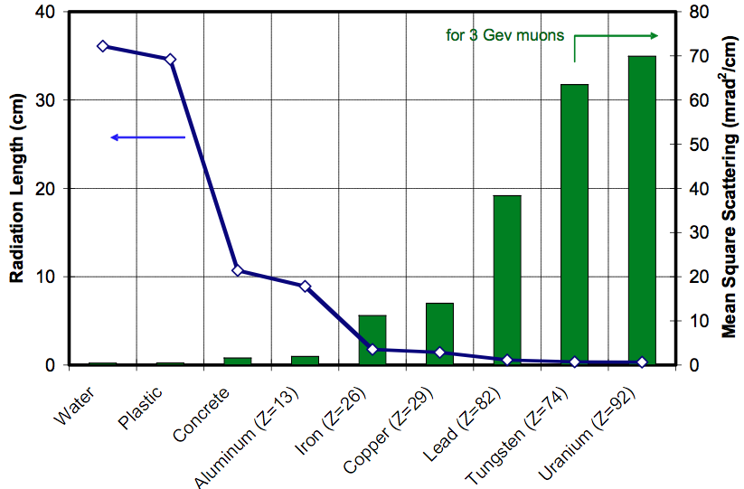
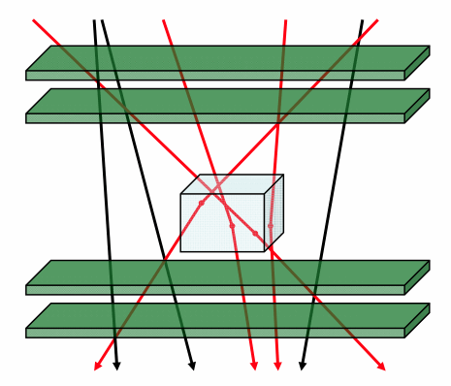
Muon radiography…for security
Uses scattered cosmic ray muons
Muons deflect more on high density materials (like Uranium)
Big advantage…cosmic rays are free

Slide 40
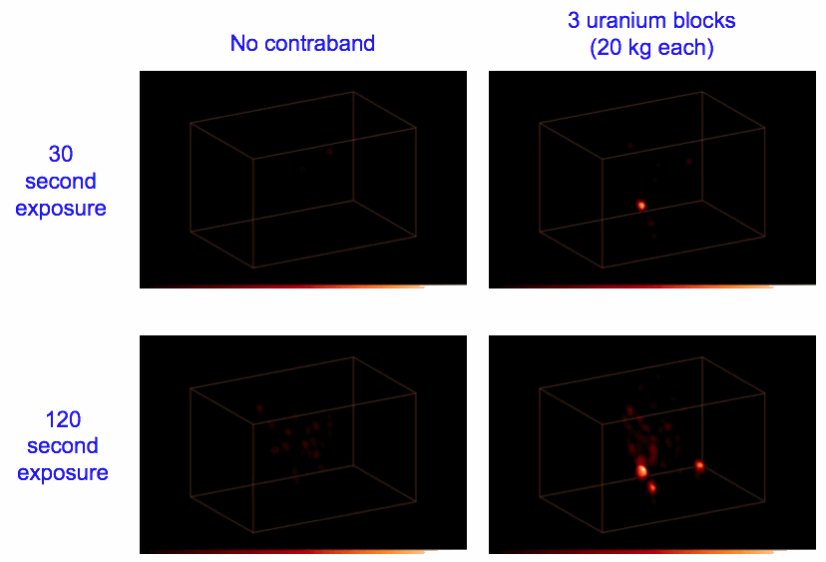
Muon radiography…for security
Test with 20kg blocks of uranium hidden in a shipping container filled with 10 tons of steel

Slide 41
μ
What are they good for?
Muon radiography
Muon catalyzed fusion

Slide 42
μ
Why are muons important to Fermilab?

Slide 43
Fermilab’s plan for accelerator-based research at the lab
μ
e
These experiments all use muons produced by neutrino interactions to study the neutrinos themselves
ν_{μ}
ν_{e}

Slide 44
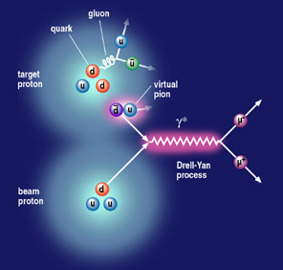
Fermilab’s plan for accelerator-based research at the lab
This experiment uses pairs of muon to study structure of protons and neutron

Slide 45
Fermilab’s plan for accelerator-based research at the lab
These two are actual “muon experiments”…they directly study muons properties and interactions.

Slide 46

Principles of Muon g-2
Pour the wine out of a bottle,
is it empty?
No, it still has air in it.
Pump the air out, so that it is a “perfect vacuum”, now is it empty?
No, it could have light passing through.
Assume the bottle is black, now is it empty?

Slide 47
Principles of Muon g-2
Surprisingly, the answer is still no!
Even in a perfect vacuum, pairs of particles are continually popping in and out of existence
e⁻
e⁺
e⁻
e⁺
e⁺
e⁻

Slide 48
What’s that got to do with muons?
e⁻
e⁺
These “virtual” particles effectively screen the muon’s view of the field
The precession frequency will change ever so slightly
e⁺
e⁻
e⁻
e⁺

Slide 49
What’s that got to do with muons?
The total frequency change depends on how many types of particle there are
e⁻
e⁺
e⁺
e⁻
e⁻
e⁺
Are there undiscovered particles?

Slide 50
What’s that got to do with muons?
The frequency will also change if the muon has structure
Is the muon made of something?

Slide 51
Why do we call it g-2?
g (the gyromagnetic ratio) is essentially this frequency and it would be identically 2 were it not for the virtual particles
g=2.00233184

Slide 52


Muon g-2 measured very precisely at Brookhaven National Lab (2001)
Theory
Experiment
Would like to bring the apparatus from Brookhaven to Fermilab to improve the precision

Slide 53
Mu2e at Fermilab
Level at which muons convert to electrons
Mu2e sensitivity
Year
The Mu2e experiment will continue a long quest of looking for rare decay modes of the muon

Slide 54

Muon to electron conversion
1S Muonic Aluminum
Coherent Conversion (μ→e)
Nucleus Is Left Unchanged
¼ 4 fm
X
Muon
Converts
¼ 20 fm
e⁻
Graphic by Andrew Norman

Slide 55


Mu2e solenoids…technical marvels

Slide 56

Mu2e solenoids…technical marvels
Magnetic
Mirror Effect
5T
Gradient Solenoid Field
p
2.5T
Primary π production
off gold target
μ
π
π
¹
π decays to μ
μ is captured into the transport solenoid and proceeds to the stopping targets
Graphic by Andrew Norman

Slide 57

The biggest muon project ever…
The Muon Collider
Perhaps the best way to extend our reach at the energy frontier beyond Tevatron/LHC

Slide 58

Muon/electron collisions are cleaner
Heavy mass of muon allows circular accelerator

Slide 59
Thank you
very much!

Slide 60
extras

Slide 61



And some not so spectacular effects…

Slide 62


Muon-catalyzed fusion
The sun is powered by fusion…one process is of particular interest
(D-T fusion)

Slide 63

Muon-catalyzed fusion
Video courtesy Star Scientific

Slide 64

Muon-catalyzed fusion
One out of 6000 water molecules in the ocean contains a deuterium atom
Each gallon has energy equivalent to 300 gallons of gasoline
But some tough problems:
-no natural tritium
-“alpha” sticking problem

Slide 65
Proton (hadron) colliders can produce very complicated events
Like throwing two soup cans at each other

Slide 66


Proton (hadron) colliders can produce very complicated events
p-p collision in CMS
gold-gold collision in RHIC

Slide 67

Cleaner to smash electrons or muons
Only solution for electron accelerators …build in straight lines
Problem…particles (especially light ones)
radiate photons as travel along a curved path

Slide 68

Plan is to airlift coils to barge

Slide 69

Will need to engineer some cross-members so the cyrostats don't deform,
engineering to ensure no internal damage in transit, shock absorbers, etc.

Slide 70


S64-F specs...12.5 ton hook weight
Potential problem...heaviest coil 8 tons
and existing lifting fixture 5 tons

Slide 71


Slide 72


A closer looks at the flight path...Brookhaven

Slide 73


A closer looks at the flight path...FNAL

Slide 74

A closer looks at the flight path...FNAL

