Slide 1
Physics for Everyone: How Particle Physics Benefits Society
Elizabeth Clements
Fermilab
December 1, 2010

Slide 2
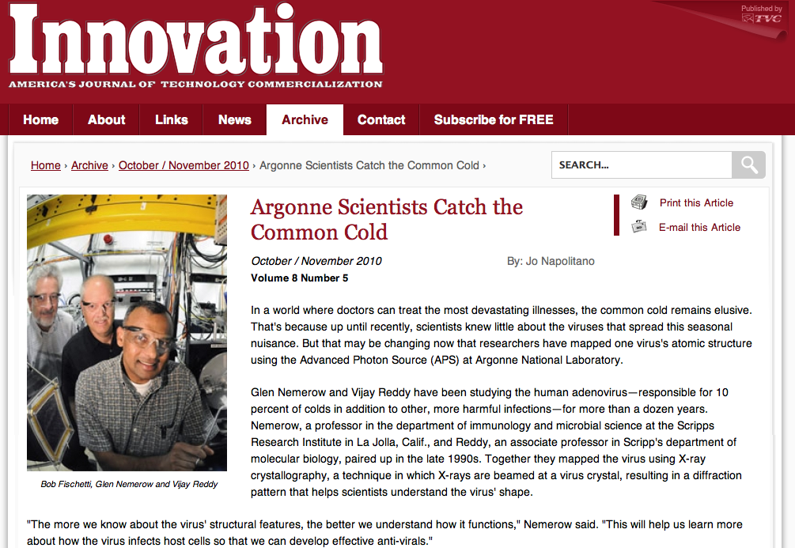

Slide 3
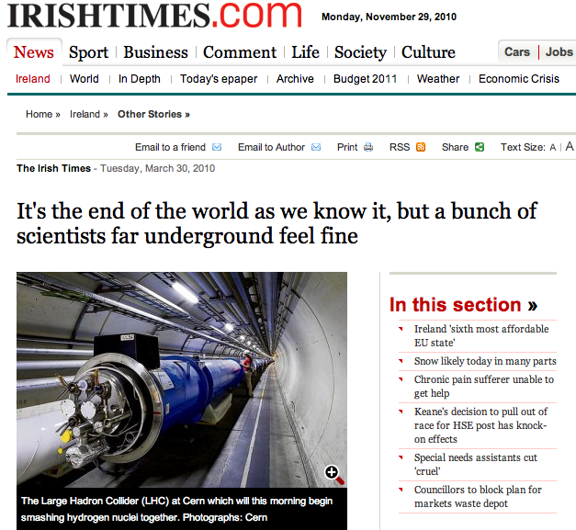
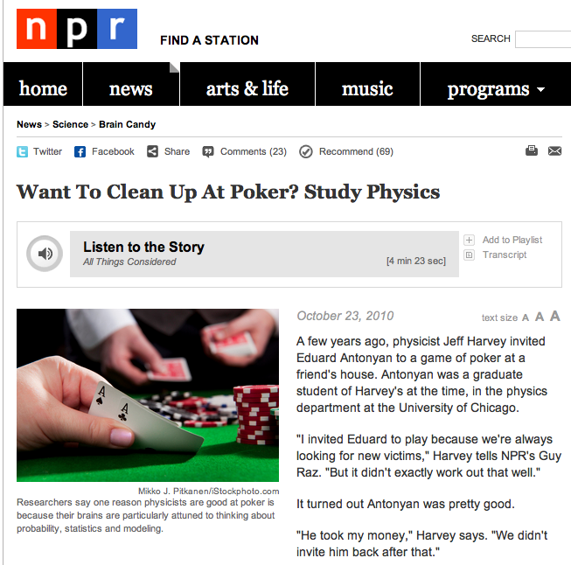
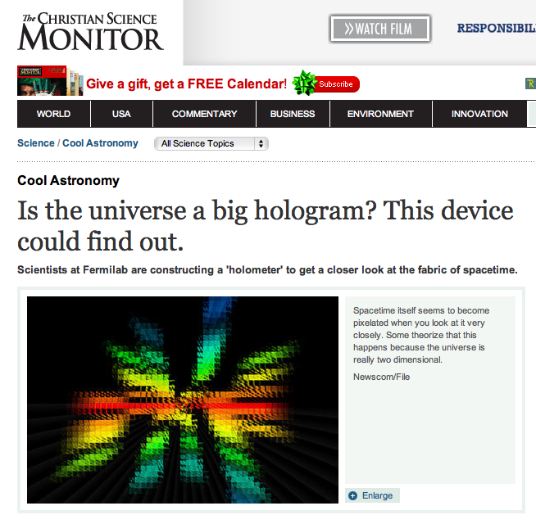
Particle physics is making headlines

Slide 4
…making it on primetime

Slide 5
…making it in Hollywood

Slide 6
…not to mention romance!

Slide 7
Behind the headlines
Roughly 30,000 particle accelerators can be found in factories, ports, hospitals and laboratories today.

Slide 8
Behind the headlines
All the products that are processed, treated or inspected have a collective annual value of more than $500 billion.

Slide 9
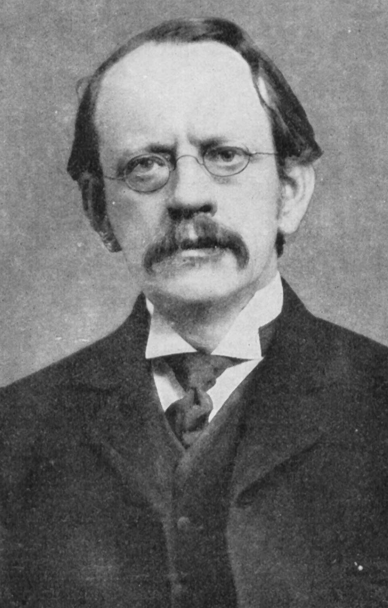
From science to society
“By research in pure science I mean research made without any idea of application to industrial matters but solely with the view of extending our knowledge of the Laws of Nature….”
JJ Thomson, 1916

Slide 10
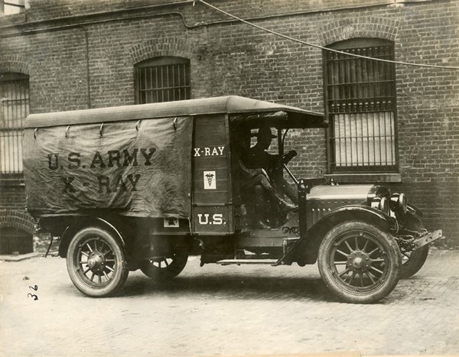
From science to society
“…No, this method is due to an investigation in pure science, made with the object of discovering what is the nature of Electricity.”
JJ Thomson, 1916

Slide 11
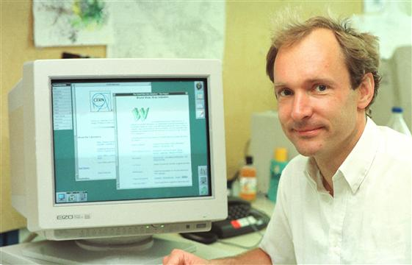
A classic example
The World Wide Web

Slide 12
The World Wide Web

Slide 13
The World Wide Web

Slide 14
The World Wide Web

Slide 15
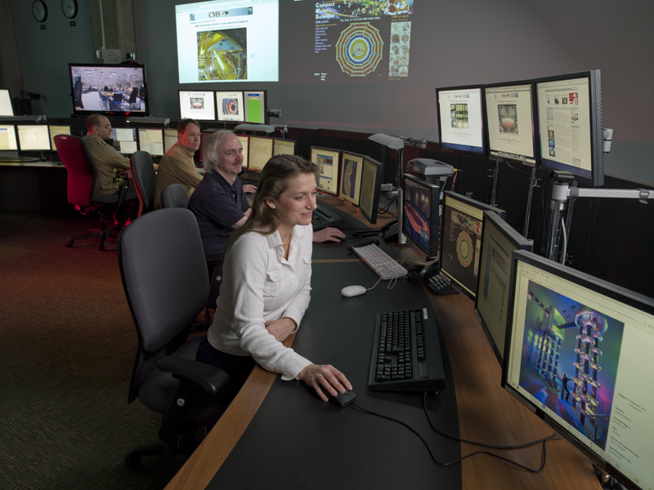
The World Wide Web
LHC Remote Operations Center at Fermilab

Slide 16
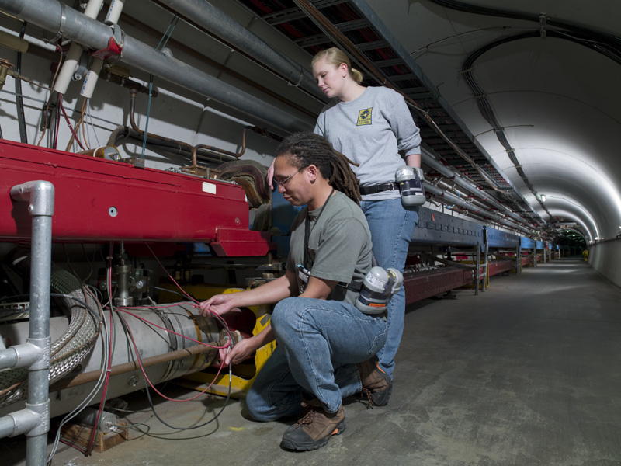
Another example close to our hearts…

Slide 17
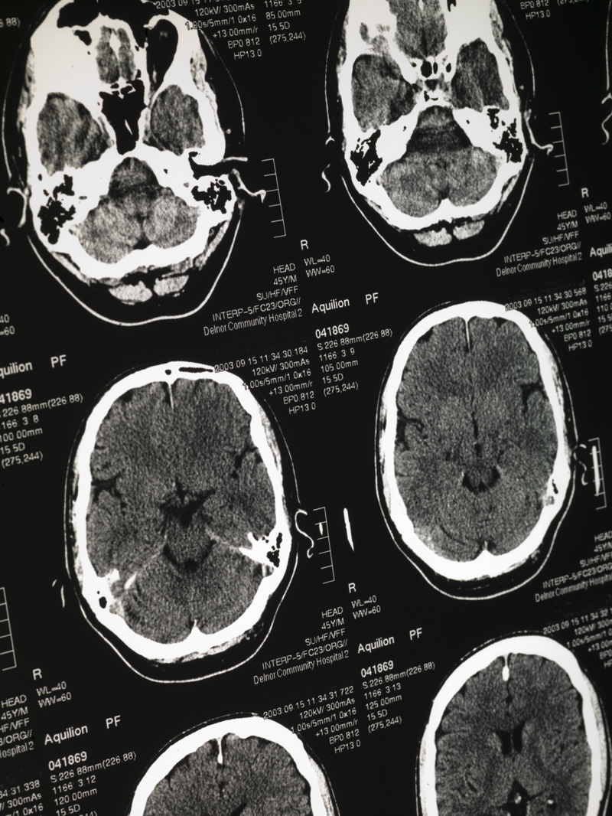
Magnetic Resonance Imaging
The superconducting wire designed for Fermilab’s Tevatron enabled the creation of powerful magnets for MRI scanners.

Slide 18
Superconducting wire by the ton
To build the Tevatron, Fermilab used 135,000 pounds of niobium-titanium-based superconducting wire and cable between 1974 and 1983.
Before that, the annual world production was a few hundred pounds.

Slide 19
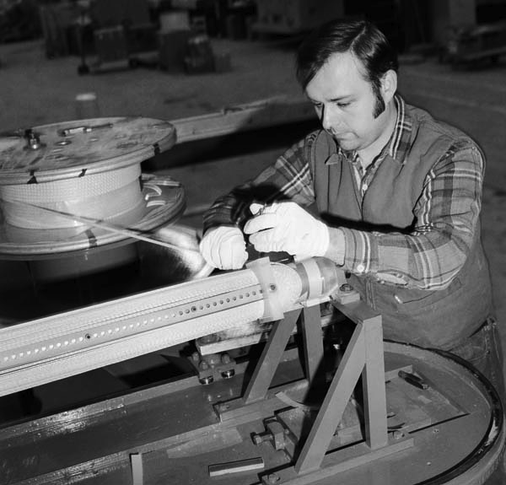
Paving the way for commercial development
Fermilab opened the
door for companies
to manufacture superconducting cable
on a larger, more affordable scale.
”Every program in superconductivity that there is today owes itself in some measure to the fact that Fermilab built the Tevatron and it worked.”
- Robert Marsh, Teledyne Wah Chang

Slide 20
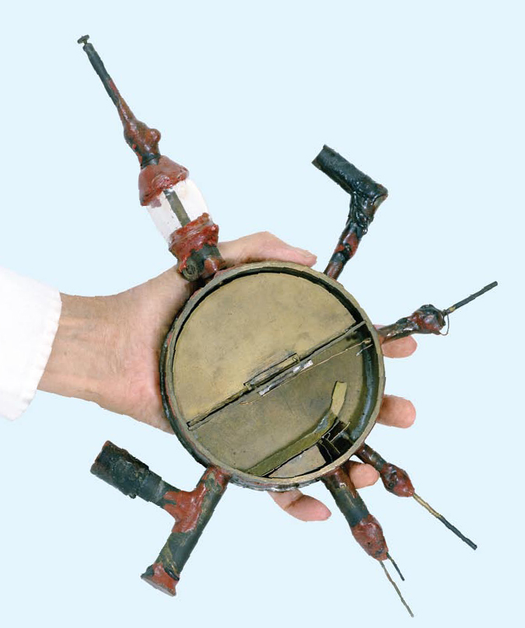
From the first cyclotron….

Slide 21
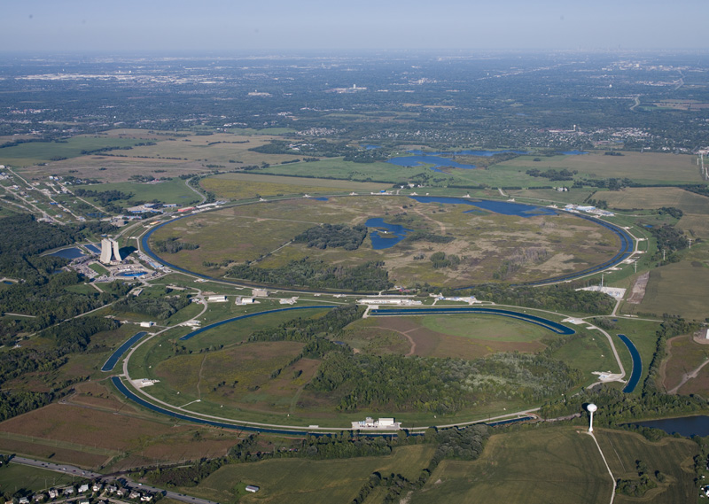
…to today’s most powerful accelerators

Slide 22
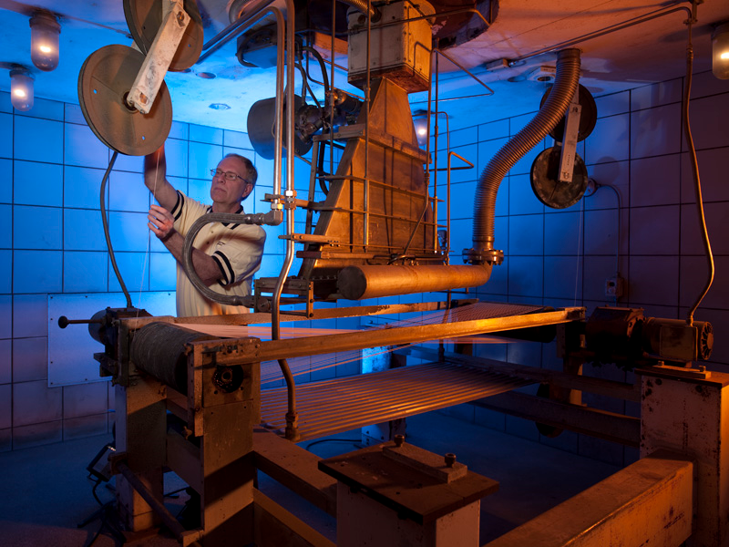
…there are many in between

Slide 23
Industry

Slide 24
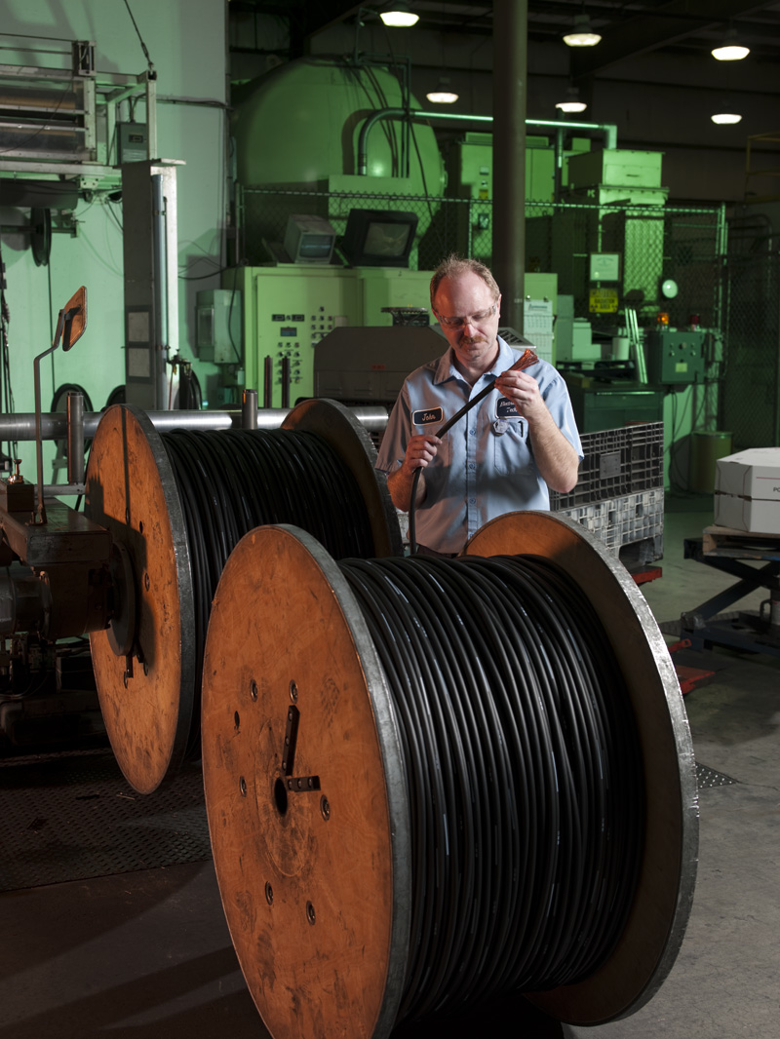
Industry
Accelerators treat the material used to insulate wires and for heat-shrinkable tubing that protects wire and cable connections.

Slide 25
Industry
Industry uses particle accelerators to produce the cross-linked shrink film that keeps many items in the grocery store fresh, such as turkeys, produce and baked goods.

Slide 26
Industry
The tire industry uses
particle accelerators to
treat the material for radial
tires, decreasing the use
of solvents that pollute the
environment.

Slide 27
Industry
Electron-beam curing of inks and coatings eliminates the use of volatile organic compounds, enabling manufacturers to attain high production speeds with minimal energy consumption and reduced environmental impact.

Slide 28
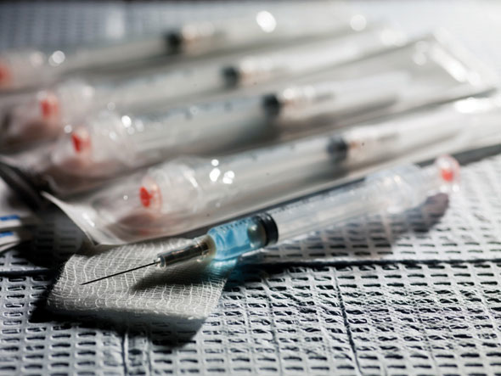
Industry
Electron beams sterilize medical equipment in a matter of seconds and are less damaging than other techniques.

Slide 29
Medicine

Slide 30
Medicine
Accelerators are needed to produce a range of radioisotopes for medical diagnostics and treatments that are routinely applied at hospitals worldwide in millions of procedures annually.

Slide 31
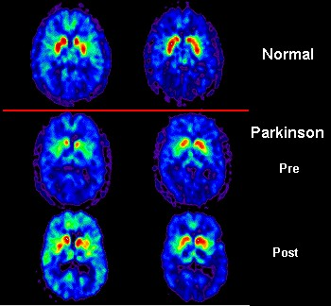
Medicine
Positron-emission tomography cameras, or PET scans, can produce detailed maps of active areas in the brain and other organs.

Slide 32
Medicine
Scientists are using technology developed for the CMS experiment at CERN in clinical trials for a new kind of PET scan to better detect breast cancer and avoid unnecessary biopsies.

Slide 33
Medicine
More than one million new cancer cases are diagnosed every year, and about half receive radiation either as their primary treatment or in conjunction with chemotherapy, surgery or other modalities. Accelerator technology, diagnostics, and treatment technique developments over the past 50 years have dramatically improved clinical outcomes.

Slide 34
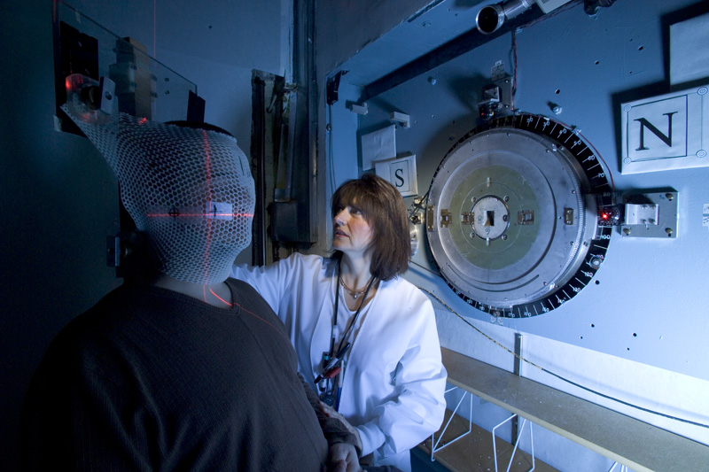
Medicine
Neutron Therapy at Fermilab

Slide 35
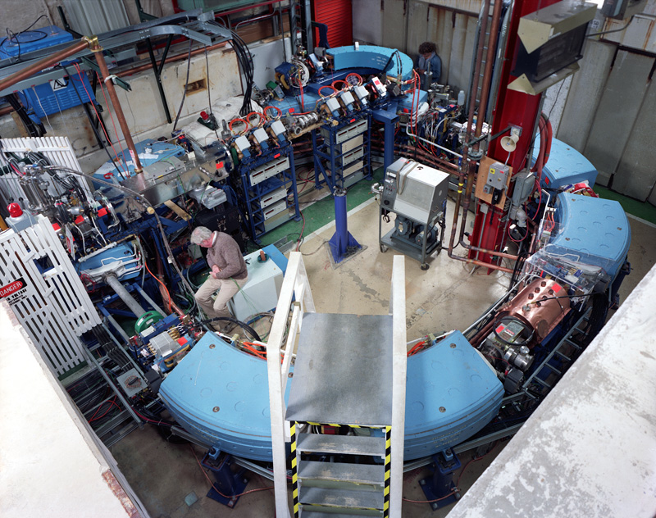
Medicine
Today, 30 proton and three carbon-ion-beam cancer treatment centers are in operation worldwide, with many new centers under construction or in the active planning stage.

Slide 36
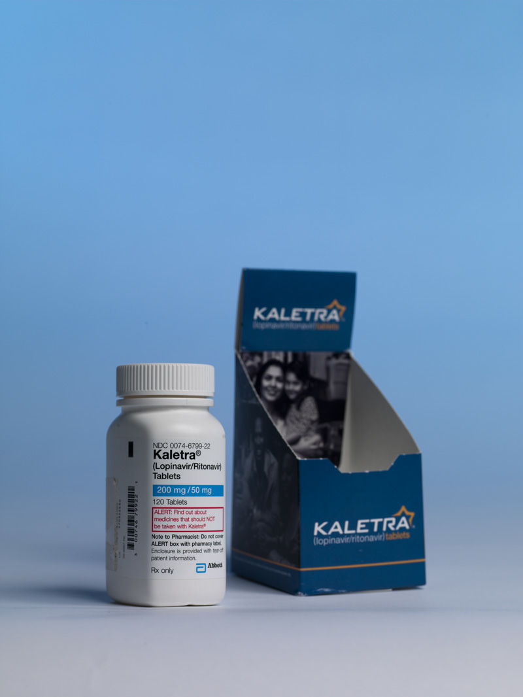
Medicine
Accelerator-driven facilities provide opportunities for pharmaceutical research and the study of complex molecules to develop new drugs, such as Kaletra, one of the world’s most prescribed medications to fight AIDS.

Slide 37
National Security

Slide 38
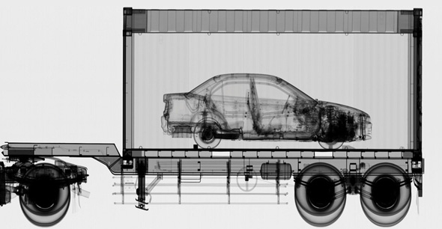
National Security
An increasing number of ports are turning to high-energy X-rays generated by particle accelerators to scan cargo for weapons and other contraband.

Slide 39
Energy and the Environment

Slide 40
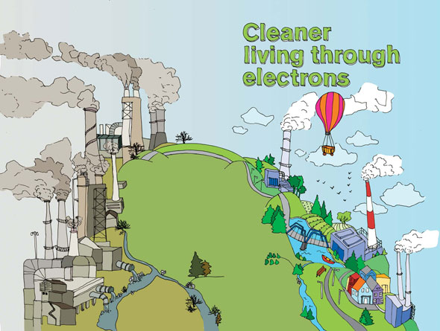
The Environment
Studies show that blasts of electrons from a particle accelerator are an effective way to clean up dirty water, sewage sludge, and polluted gases from smokestacks.

Slide 41
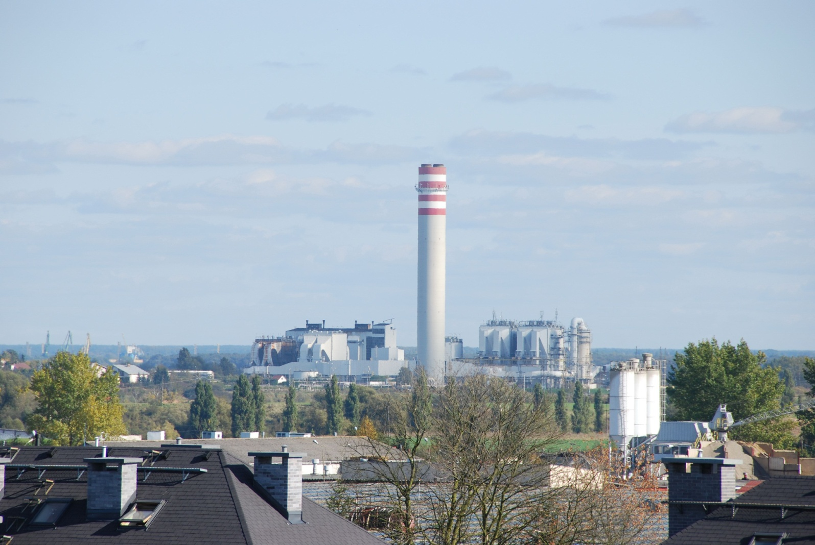
The Environment
Flue Gas Treatment

Slide 42
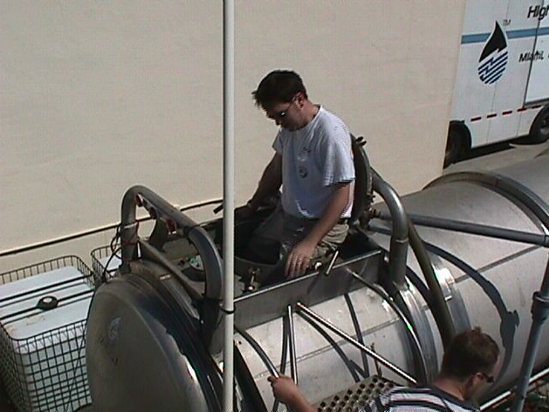
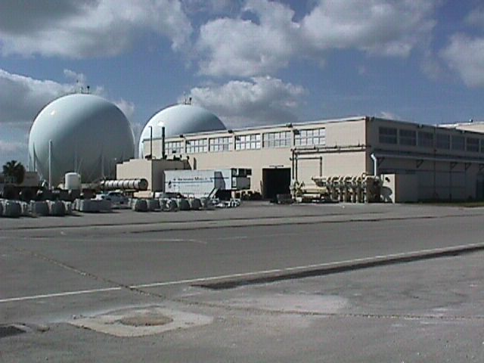
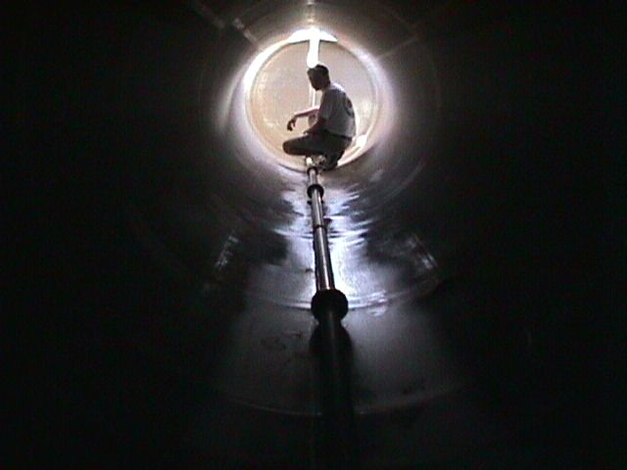
Wastewater treatment
The Environment

Slide 43
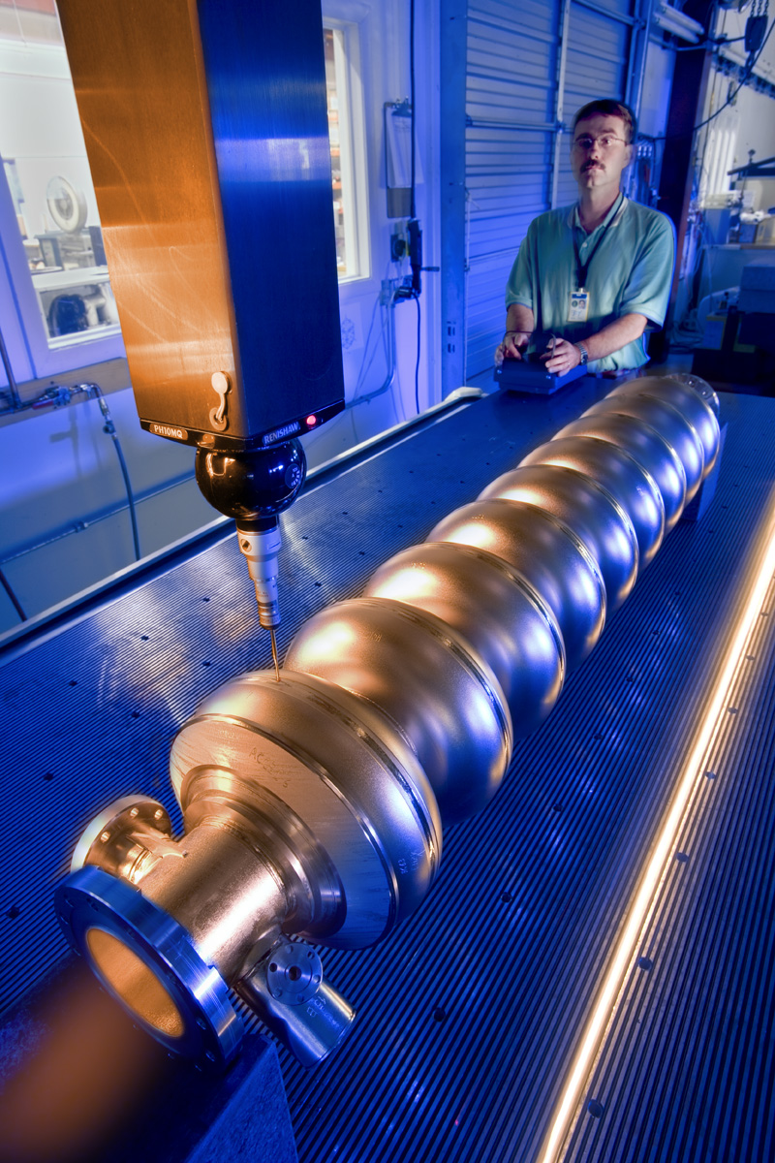
Energy
Particle accelerators have the potential to treat nuclear waste and enable the use of an alternative fuel, thorium, for the production of nuclear energy.

Slide 44
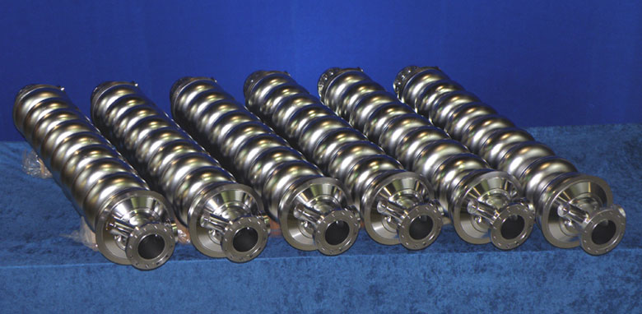
Energy
Fermilab is partnering with industry to develop and advance superconducting radio frequency cavities, a new accelerator technology with many potential applications.

Slide 45
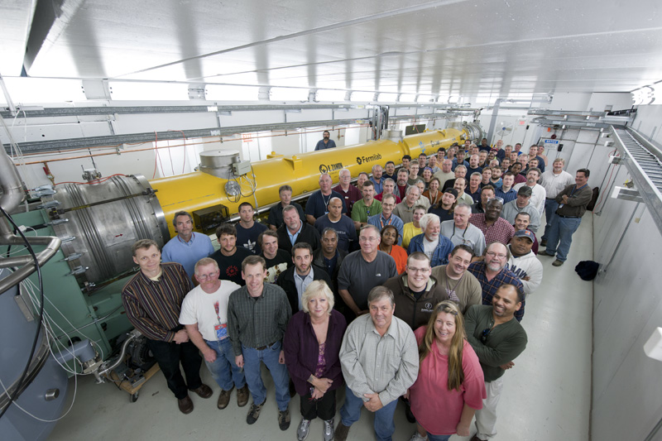
Accelerators for America’s future

Slide 46
Addressing global challenges
Health
Wealth
Energy
Environment
National security
Particle physics has a role to play in the list that is at the top of every nation’s challenges.

Slide 47
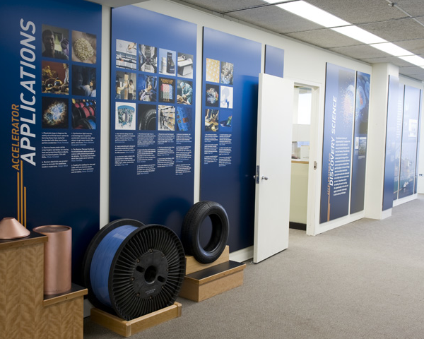
Visit the exhibit on the 15th floor

Slide 48
www.acceleratorsamerica.org

Slide 49
Thank you!
Questions?

